Slide 1
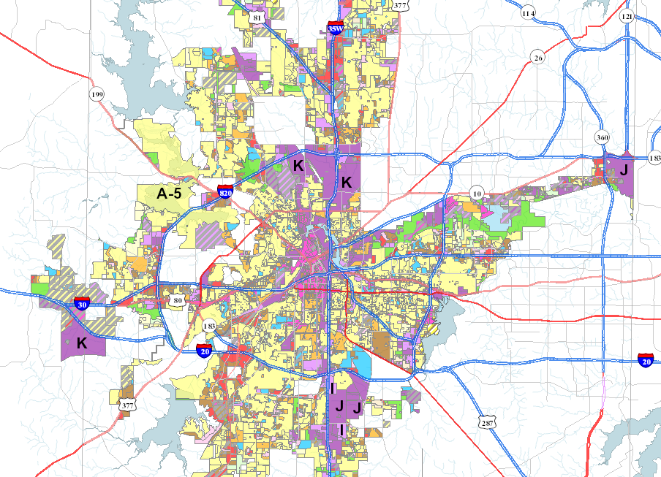
Zoning and Land Use Overview

Slide 2
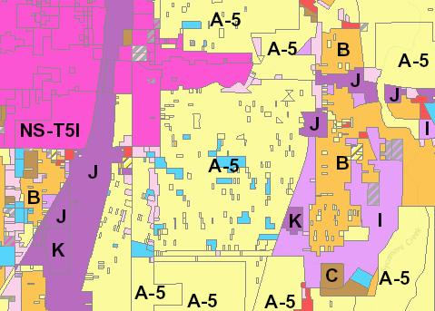
What Is Zoning?
The city promotes orderly growth and land use while protecting existing property owners by grouping together compatible land uses — a practice known as zoning.
Before land is developed in the city, it must be zoned and platted. Property in the city’s extraterritorial jurisdiction (ETJ) is subject to platting only.
The Zoning Commission reviews all zoning requests to provide recommendation for City Council, who will approve or deny the request.
The Zoning regulations and districts are adopted to help implement the Comprehensive Plan and its policies.

Slide 3
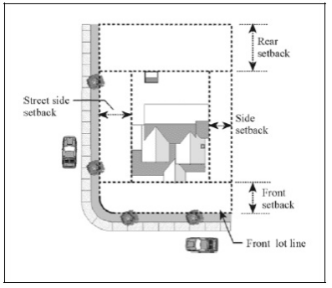
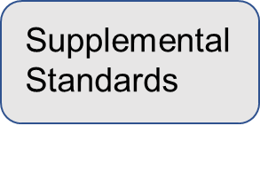
What Does Zoning Regulate?
Lot Size
Parking
Height
Landscaping
Setbacks
Signs
Land Use

Slide 4
The Different Roles Of Zoning
Responsibilities:
Zoning Change
Land Use
Bulk, Mass and Site Aesthetics
Responsibilities:
Historic Preservation Program
Urban design & form-based code districts
Commission administration
Responsibilities:
Design review
Board administration
Community engagement
Responsibilities:
Design Review
Prepares written reports to Boards
Public Approvals Process
Responsibilities:
Exceptions for Certain Structures
Zoning Standards Waivers
Quasi-Judicial

Slide 5
Development Services works with the community to create and adopt plans that ultimately lead to the regulatory documents that encompass zoning:

Slide 6
Related Zoning Topics
Zoning Districts
Comprehensive Plan
Rezoning Property
How Citizens are Involved
Resources

Slide 7
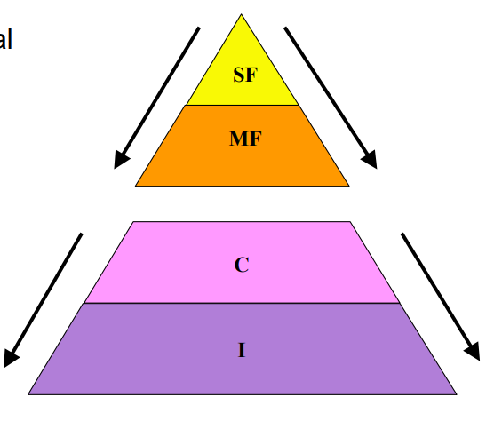
Zoning Districts
Partially Cumulative Zoning
Zoning categorizes land use in two ways:
TYPE of land use
INTENSITY of land use
Some less-intensive uses are allowed in more-intensive use areas:
Lower-density residential is allowed in higher-density residential districts
Commercial uses are allowed industrial districts, but…
Residential uses are not permitted in non-residential districts because they’re different types of land use

Slide 8
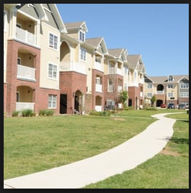
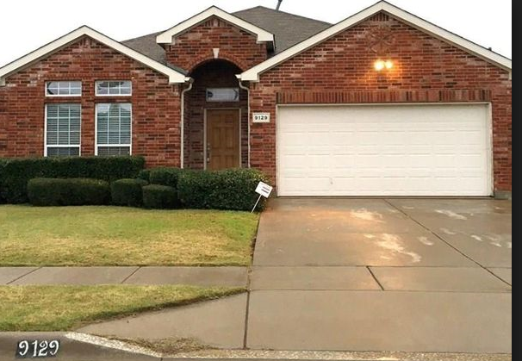
Zoning Districts
Residential:
“A-Districts” allow single-family uses (single-family home)
“B-Districts” allows duplex and single-family uses
“C-Districts” allow multifamily (apartment), duplex, and single-family up to 24 units per acre
“D-Districts” allows up to 32 units per acre

Slide 9
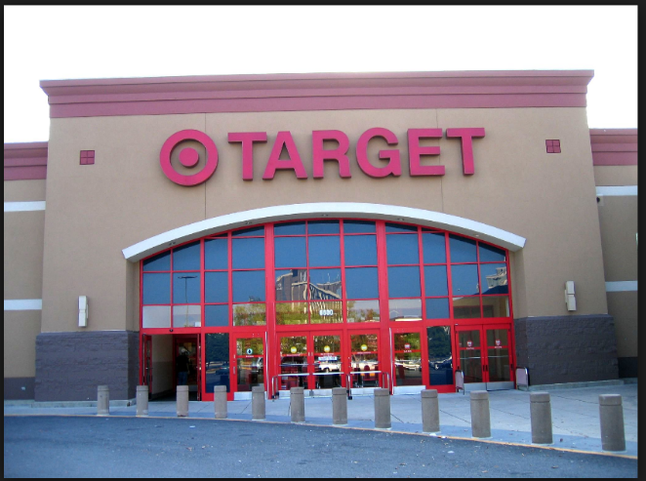
Zoning Districts (Continued)
Commercial:
“E-Districts” allow neighborhood commercial uses (convenience stores, restaurants, offices and other uses)
“F-Districts” allow general commercial uses (Everything in “E” plus bars, automotive uses, tattoo parlors and other uses)
“G-Districts” allows intense commercial uses (Everything in “F” plus max height of 120 ft.)

Slide 10
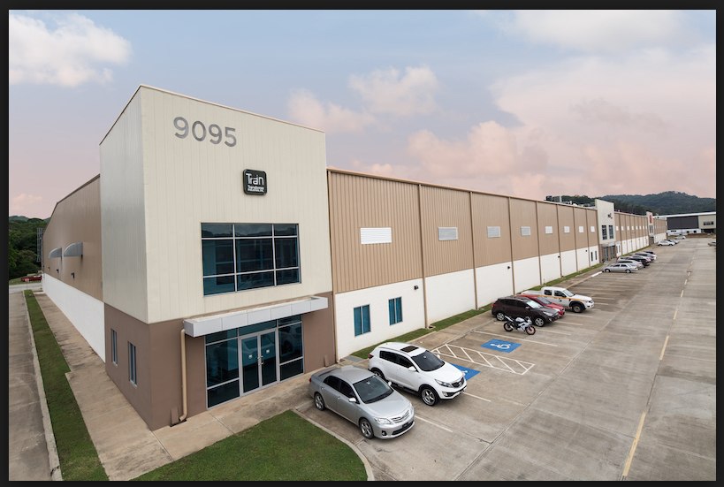
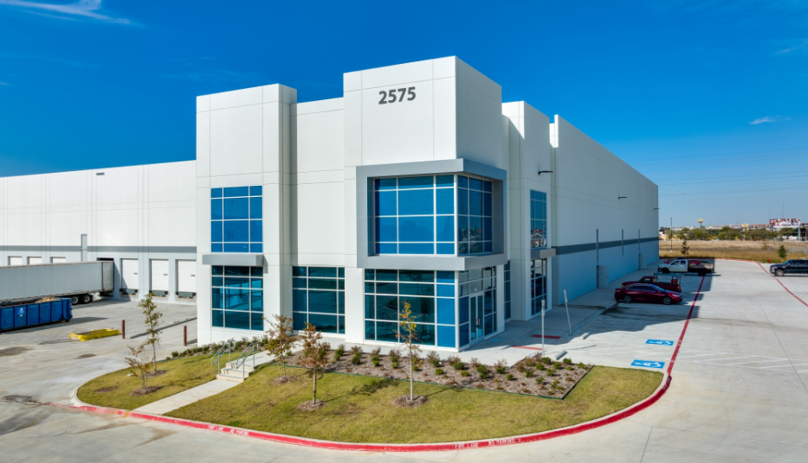
Zoning Districts (Continued)
Industrial:
Allows all commercial uses
“I-Districts” allows light industrial uses (light industrial uses especially warehouse/ distribution/light manufacturing and outdoor storage)
“J-Districts” allows uses in “I” and heavier industrial uses
“K-Districts’” Heavy Industrial (Allows outdoor industrial uses that may have dust, odor, etc.)

Slide 11
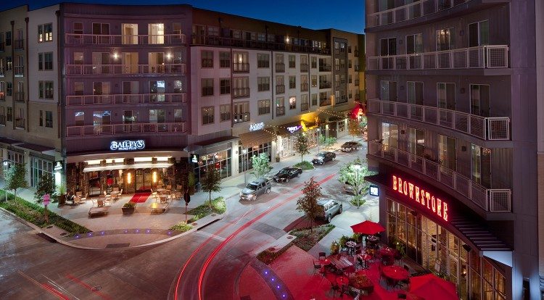
Zoning Districts (Continued)
Mixed-Use & Form Based Districts:
“MU-1” Mix of commercial and residential uses allowed
“MU-2” Mix of commercial and residential uses and allows some light industrial
“Form Based Districts’” Based on form and function allows a mix of uses
https://r-o.com/uploads/portfolio/0_306410621_west-7th-012-614164630.jpg

Slide 12
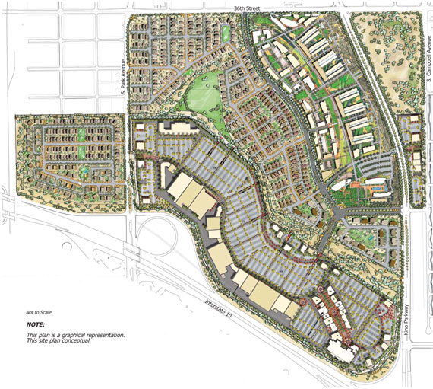
Planned Development “PD” Districts
Is a zoning district change, not an overlay - cannot revert
Encourages unified design of residential, commercial, industrial and institutional uses, including combinations of uses that are not otherwise attainable under conventional base zoning districts.
A PD can be requested for any land use:
Mixed use, single family, multi-family, commercial or industrial uses
Provides details and allows additional restrictions, Site-specific – typically based on site plan Site provides control over use, height, materials, signage, fencing/buffering, landscaping, etc.
https://projectsintl.com/images/Bridges-Illustrative-Site-P.jpg

Slide 13
What Does The Zoning District Mean?
The entire zoning ordinance is over 500 pages
Each zoning district has its own Section with basic setbacks and other standards
Allowed uses can be found in the use tables
The ordinance also has supplemental standards, mostly when non-residential districts are located adjacent to residential districts, that may include:
Supplemental setbacks
Screening fence/landscaping
Projected setbacks
Required parking
PDs have their own ordinance and site plan that are on file with Development Services

Slide 14
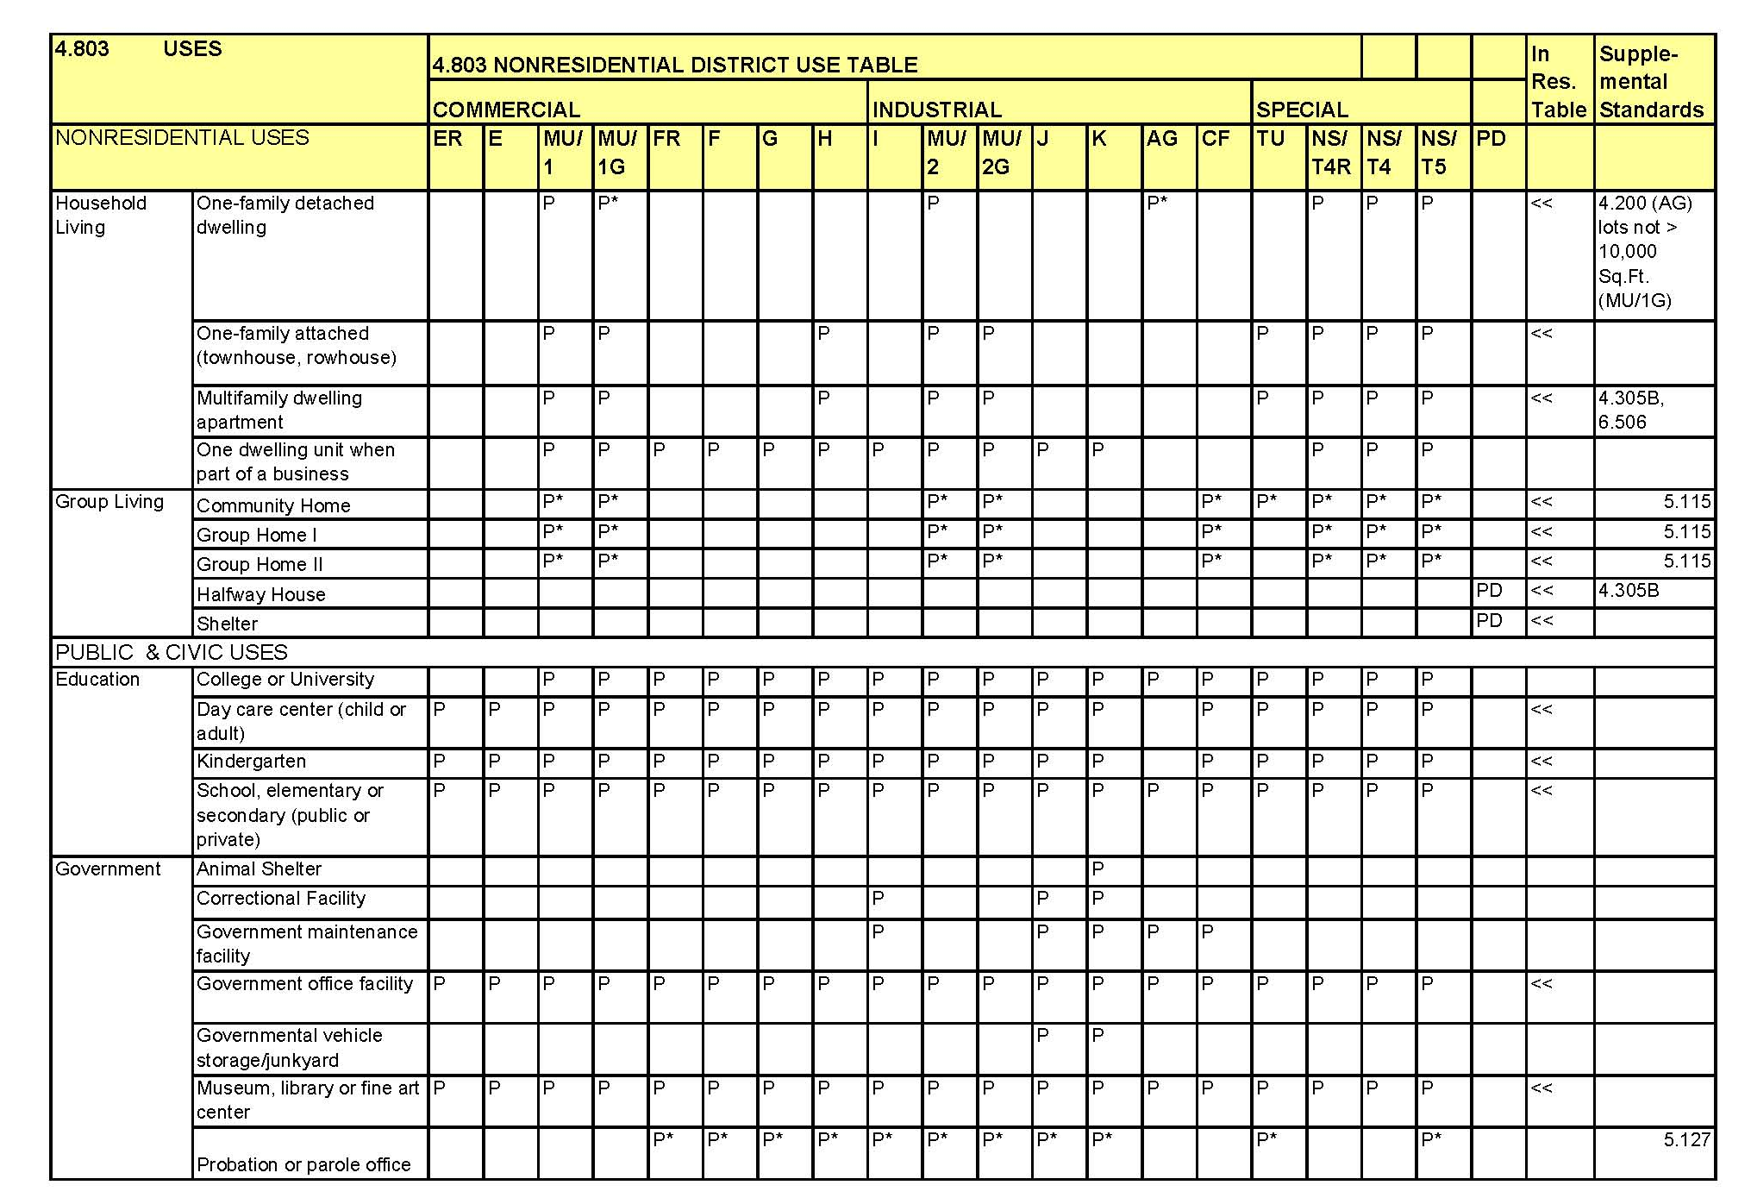
Use Tables
Permitted Use (P). Permitted use in respective zoning district – may be subject to supplemental development standards
Special exception uses (SE). Permitted only as a Special Exception
Conditional Use Permit (CUP). Permitted only under the approval of a CUP – Use requires additional scrutiny based on location
Uses not allowed. An empty cell indicates that a use is not allowed in the respective zoning district.
Use
Type
Use
Zoning Districts
Supplemental
Standards

Slide 15
What is The Comprehensive Plan?
The Comprehensive Plan is a general guide for making decisions about the City’s growth and development
Presents a broad vision for Fort Worth’s future and describes major policies, programs, and projects to realize that vision

Slide 16
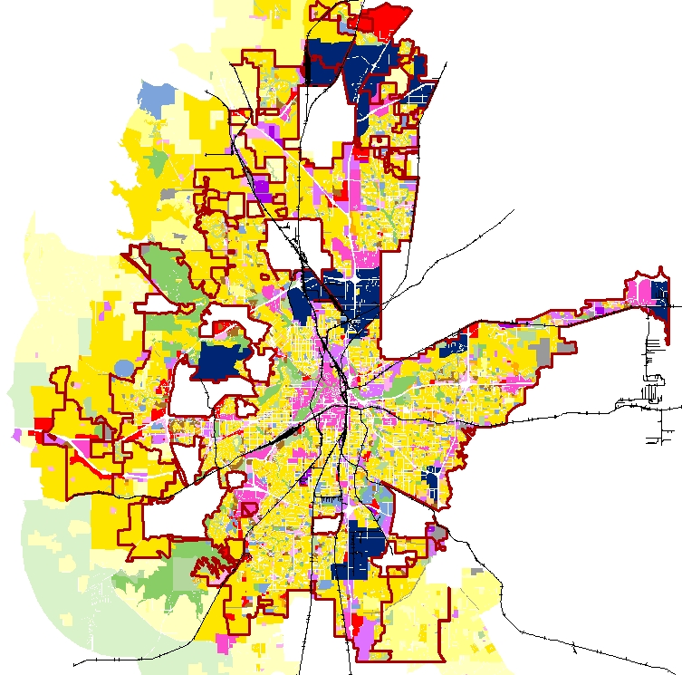
Future Land Use Map
Is an Appendix to the Comprehensive Plan that shows the community’s preference for appropriate locations of future land uses. The map illustrates the City’s vision for the placement of housing, employment, social activities, and protection of natural areas.
Staff provides an analysis in zoning case reports on whether the proposed use is appropriate for the area.
Zoning reports evaluate the consistency with existing land use and conformity with Comprehensive Plan policies and the Future Land Use Map.

Slide 17
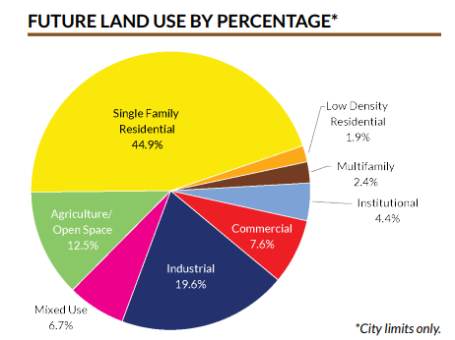
How Does the Comprehensive Plan affect Zoning?
Zoning implements the Future Land Use Plan as rezoning requests are submitted to the City.
The Comprehensive Plan policies and Future Land Use Map and are referenced by elected and appointed officials when making zoning decisions.
Future land uses and development forms are defined and categorized with the appropriate zoning classification.

Slide 18
Rezoning Process

Slide 19
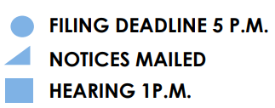
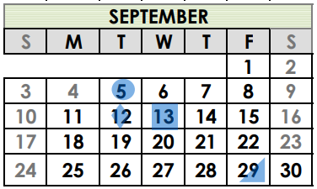
Rezoning Process
Roughly 2 ½ to 3-month process
Not guaranteed
Application submittal
Identifies property and zoning district requested
Signed by property owner
Zoning Commission (1st Public Hearing)
Recommending body
City Council (2nd Public Hearing)
Final Determination
Public Hearings are Hybrid
In Person or via Webex

Slide 20
Rezoning Process
Application Submittal
Courtesy Notices
Legal Notice
1st Public Hearing Zoning Commission
2nd Public Hearing City Council
Applicant submits an application with the legal description. Recommend applicant contact the neighborhood and Council office if difficult case
City emails courtesy notices 10 days before hearing to registered organizations within ½ mile
Staff reviews case and legal notice is mailed to property owners within 300 ft. 10 days before hearing. A sign is placed on the property
Public Hearing is held at the Zoning Commission, 2nd Wednesdays at 1 p.m.
Public Hearing is held at City Council meeting. Zoning cases are typically heard the second or third meeting of the month, Tuesdays at 6 p.m. Ordinance is adopted or denied in one reading

Slide 21
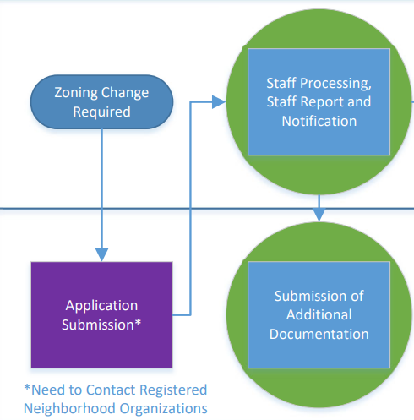
Rezoning Steps And Best Practices
Step 1: Use our interactive map and the neighborhood database to find and contact the neighborhood and property owners (300 ft) about your proposed change.
We recommend doing this prior to submitting a zoning change application
This will give you a good idea where they stand
The Zoning Commission will ask if you have met with the neighborhood

Slide 22
Rezoning Steps And Best Practices
Step 2: Submit your zoning application (Typically, the 1st Monday of the month is the deadline)
Example: Submit application (September deadline)
Zoning Commission (October)
Council (November)
Please fill out the description section
Provides Zoning Commission and Council a narrative of zoning proposal
Make sure to provide all the correct documents, or the case will be withheld.

Slide 23
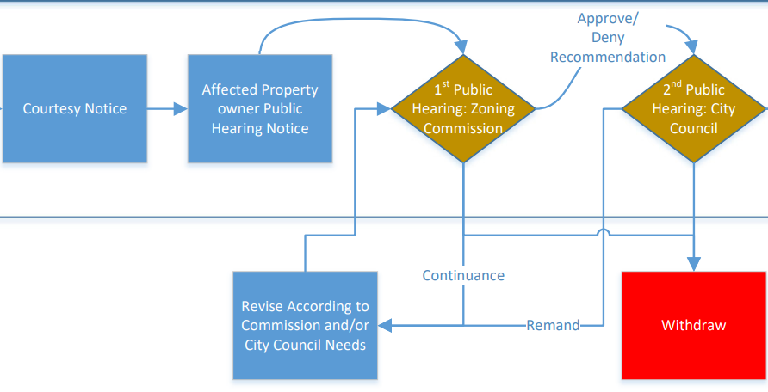
Rezoning Steps And Best Practices
Step 3: Zoning Commission
Staff Prepares a report
Land use compatibility / Comprehensive Plan consistency
Staff makes recommendation
Provides applicant correspondence (week of hearing)
Sign-up to speak prior to the public hearing
Link on agenda
Send city staff your PowerPoint by the Monday prior to the public hearing

Slide 24
Rezoning Steps And Best Practices
Step 4: City Council
Recommendation from Zoning Commission moves forward to Council
City Council is final authority
The Zoning Commission often provides guidance on interactions with neighborhoods etc. prior to Council meeting
Sign-up to speak prior to the public hearing
Link on Council Agenda

Slide 25
Options For City Council Motions For Zoning Cases
The City Council has the below alternates for findings:
Approve as recommended;
Deny with prejudice; no new applications of like nature shall be accepted within a period of twelve (12) months. Also applies when the applicant has withdrawn his proposal after Zoning Commission recommendation of Denial;
Deny without prejudice; no one year wait period;
Continue case to future hearing date; re-send notices if necessary;
Return (remand) to Zoning Commission for rehearing

Slide 26
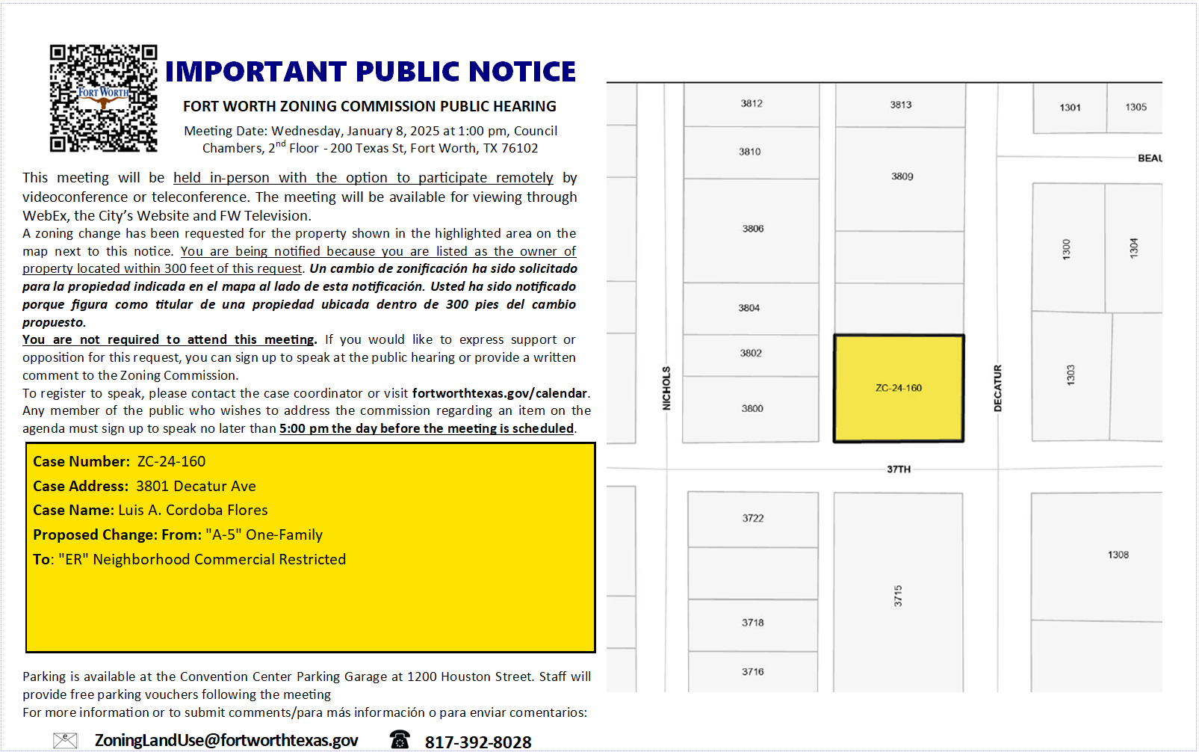
Who We Notify
All property owners as indicated on the municipal tax roll and within 300 feet of the property requesting rezoning will receive a notice by mail
Scan the QR Code on the top of the notice to find out more details of the request

Slide 27
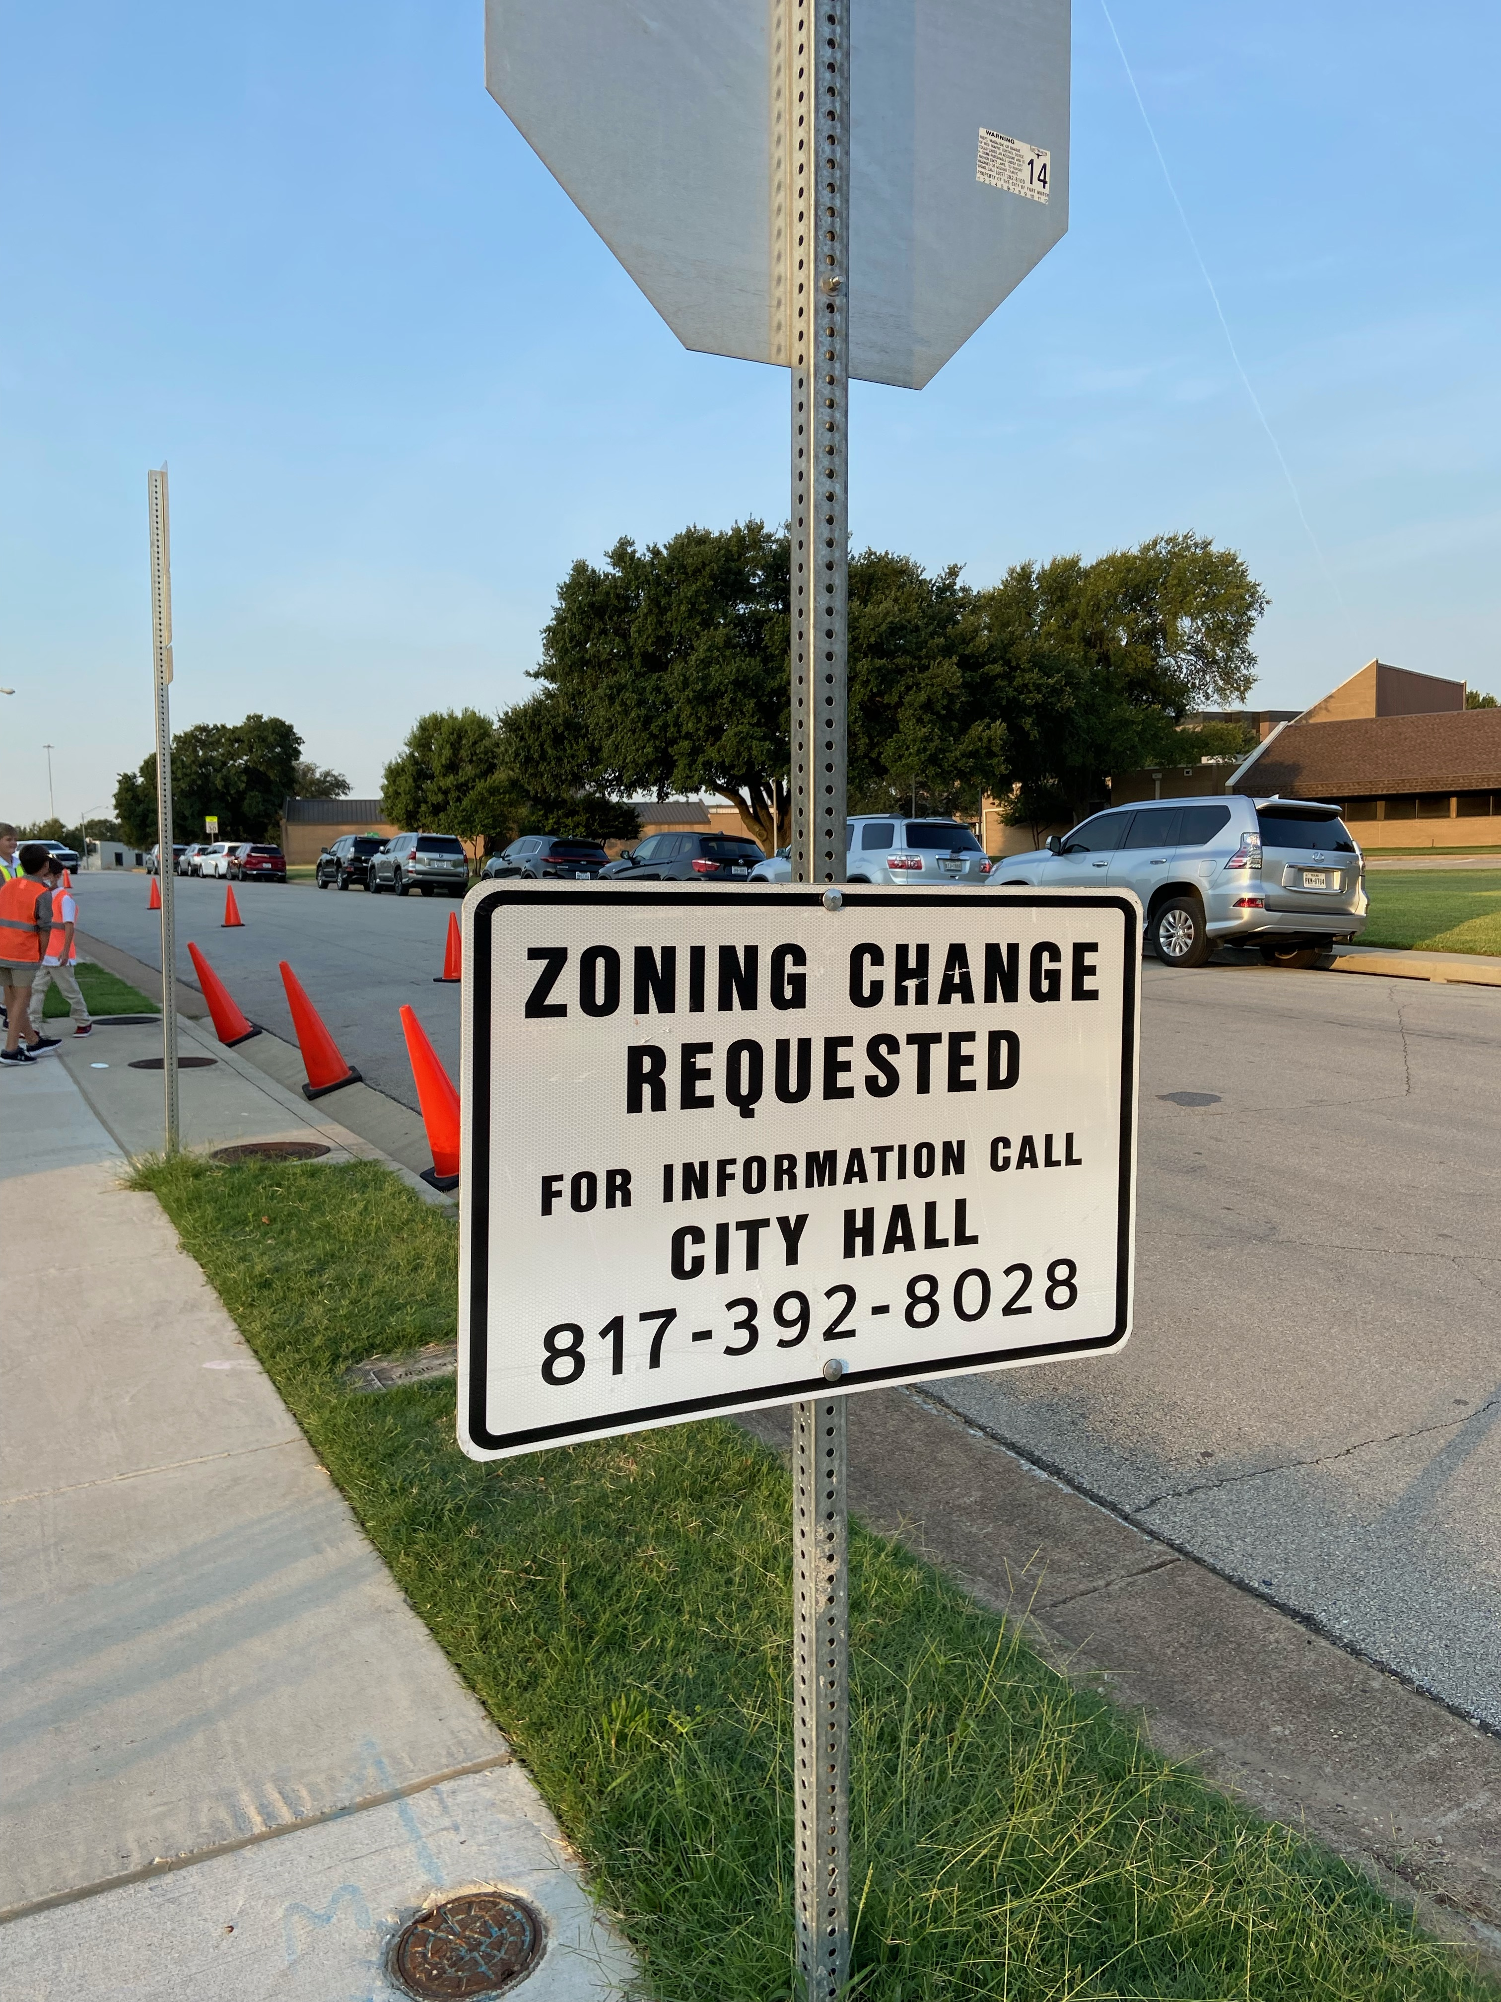
Who We Notify
Registered Neighborhood Organizations are notified within a ½ mile of proposed zoning changes
Sign will be placed in front of proposed rezoning
NEW - Email list serve
Citizens sign up for Zoning Cases each month in their district

Slide 28
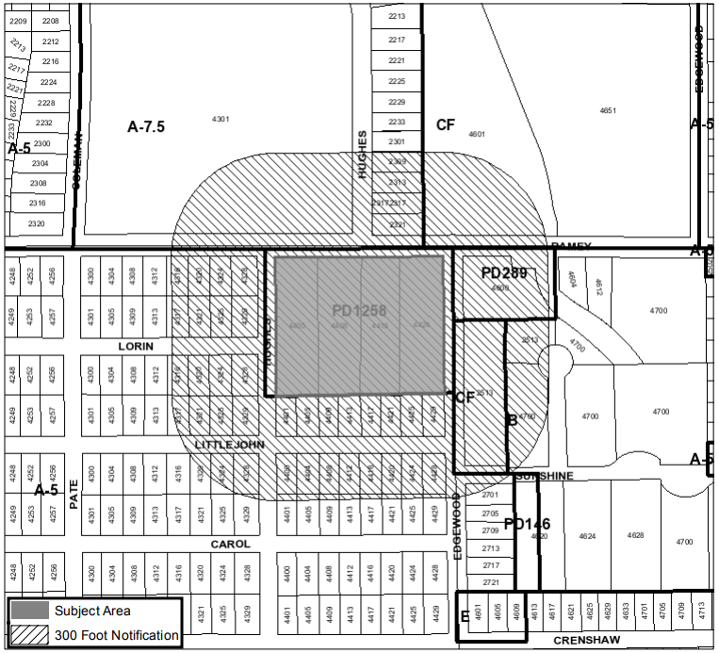
Who We Notify
Visit www.fortworthtexas.gov/departments/development-services/zoning to view the Upcoming Boards and Commissions Story Map to view location and details of the request

Slide 29
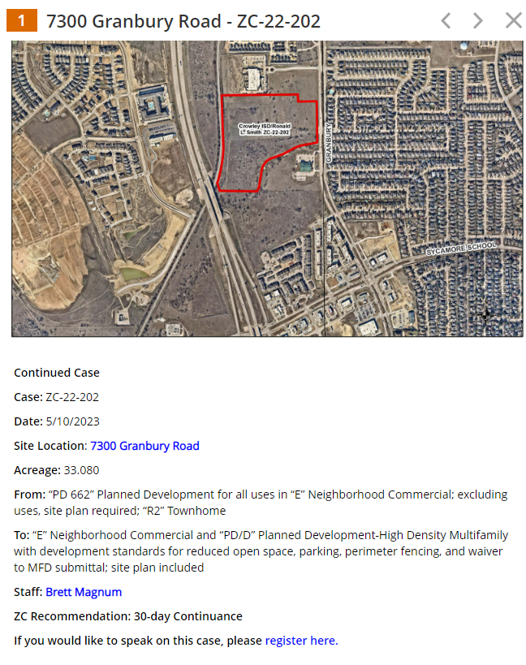
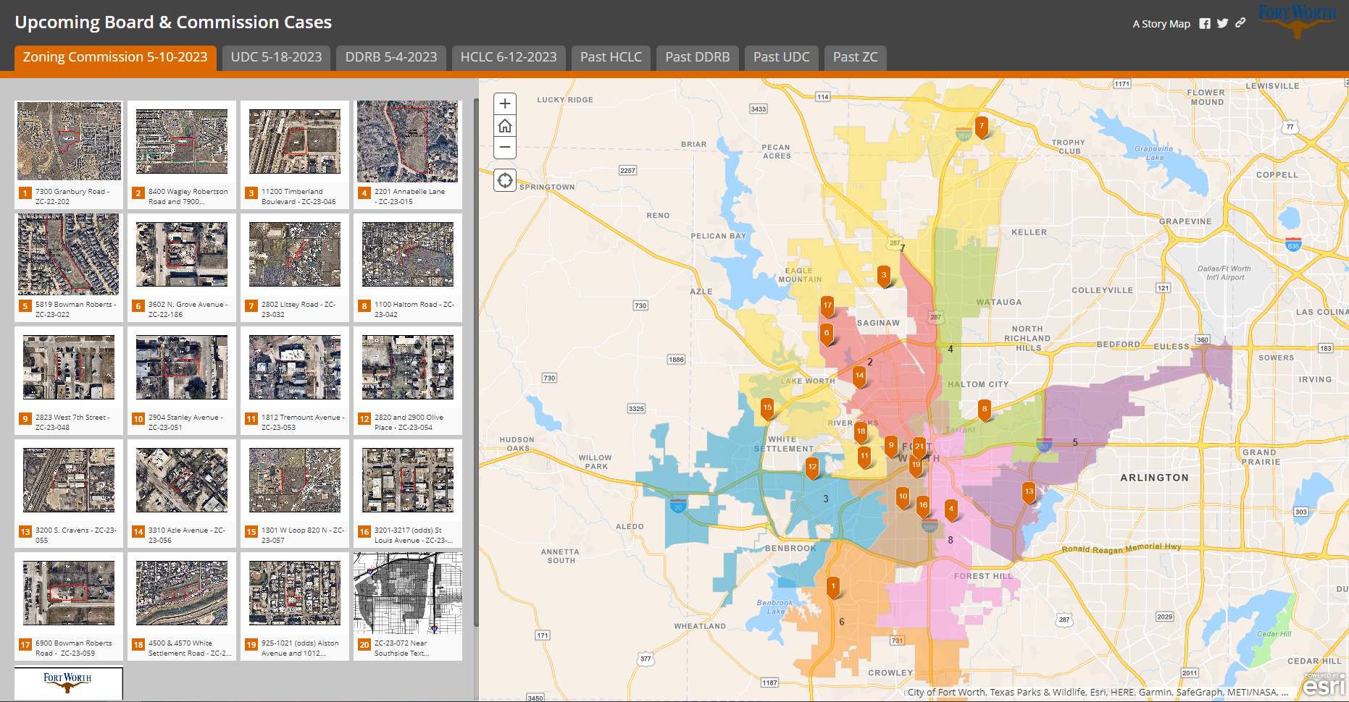
How To Find A Zoning Change
View the Story Map
Click on the Case You Want to View
Review request and any attached details such as a site plan if applicable

Slide 30
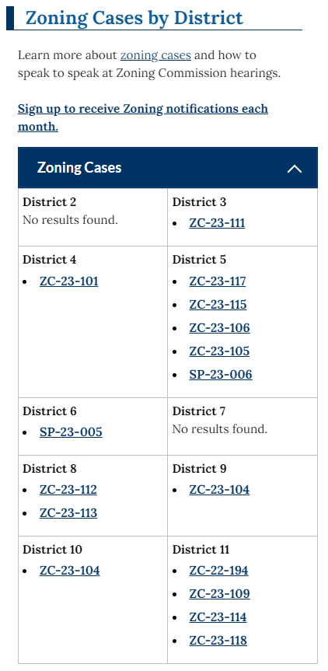
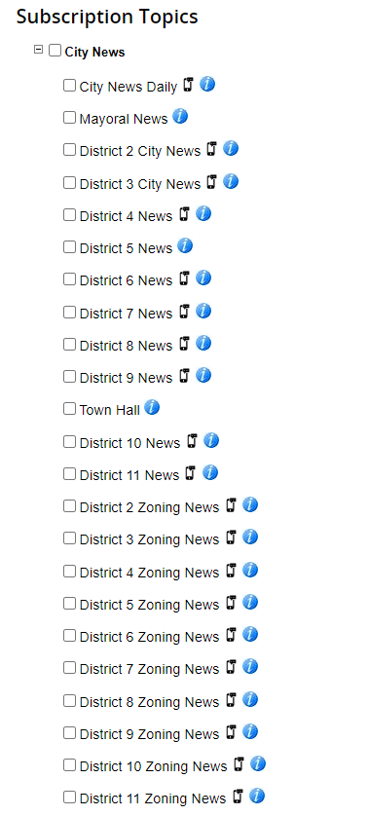
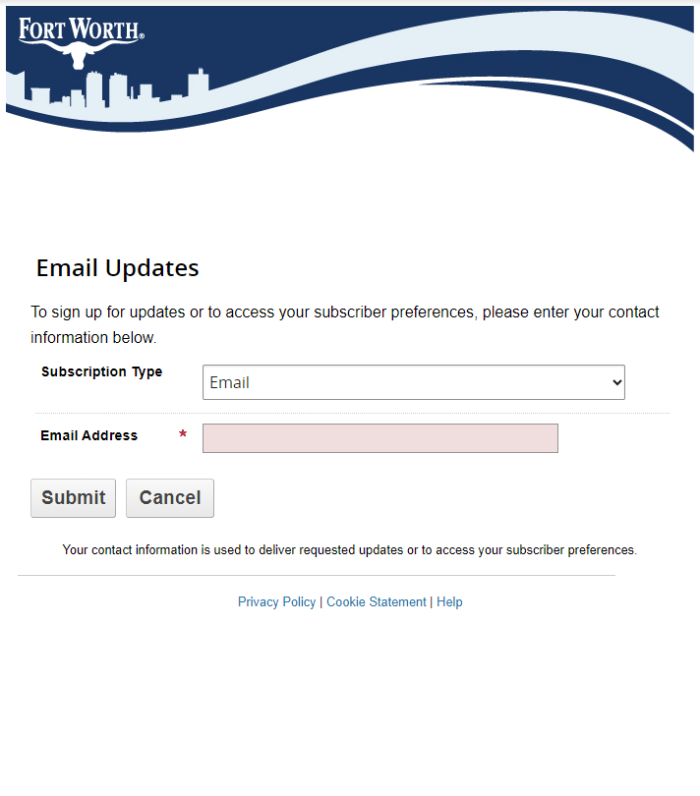
Email List Serve
Sign up for "push" notifications
Receive information on upcoming zoning cases by Council District
You can register for multiple Council Districts
Zoning – Welcome to the City of Fort Worth (fortworthtexas.gov)

Slide 31
Citizen Involvement
Attend public hearings on zoning cases located in/near your neighborhood
Zoning Commission
Applicant has 5 minutes to speak
All opposition has 7 minutes to speak unless extra time is granted
Applicant is provided 2 minutes to address any public comments given
City Council
Each individual has 3 minutes to speak

Slide 32
Citizen Involvement
Citizens may provide correspondence on zoning cases located in/near their neighborhood
Email correspondence to:
zoninglanduse@fortworthtexas.gov
Include the Zoning Case Number
Provide specific reasons for support/opposition to the case
Helpful to get the information to us Monday prior to the meeting

Slide 33
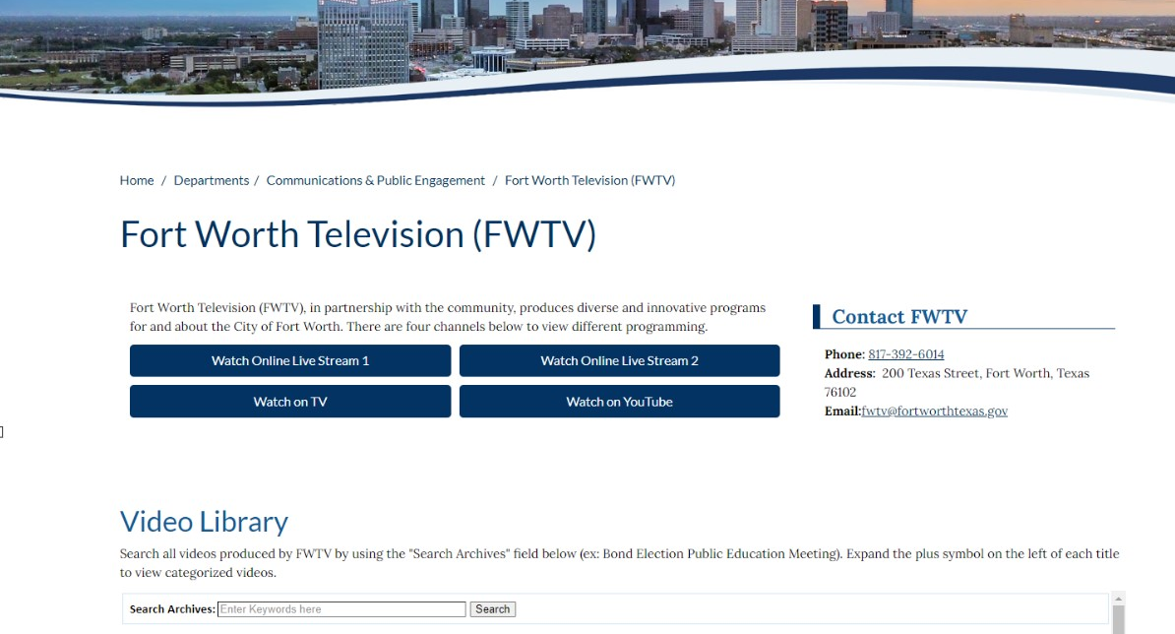
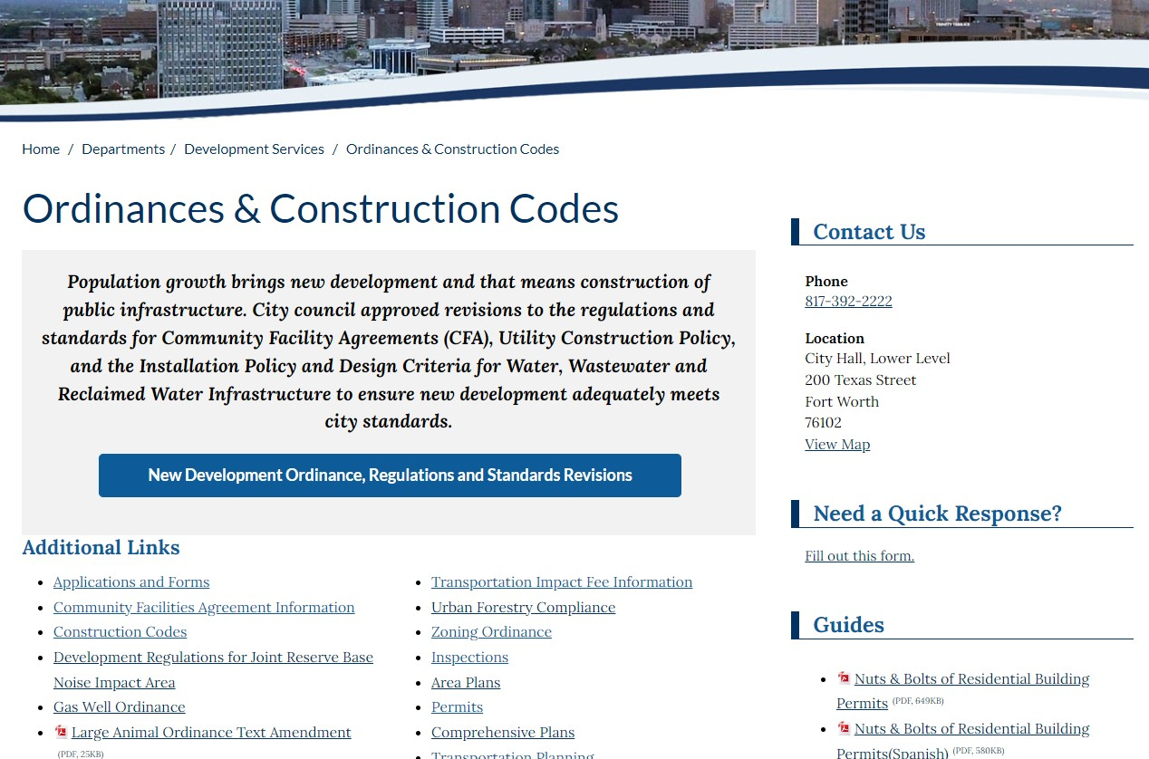
Resources
City of Fort Worth Zoning
Zoning Map
Ordinance
Story Map
Fort Worth Television

Slide 34
Thank You

