Slide 1


OCTOBER 7 – OCTOBER 25, 2024
OPEN ENROLLMENT FOR PLAN YEAR 2025
Presented By Human Resources Department

Slide 2
OE FAST FACTS
Online Access To Enroll via our online system cfwbenefits.com Starts October 7th
Open Enrollment Deadline for ALL Plans is October 25, 2024, 11:59 pm
Changes Are Effective January 1, 2025

Slide 3
What’s Changing?
Medical
Health Savings Account
Slight increase to premiums
Increase individual contribution limit to $4,300
Increase family contribution limit to $8,550
City contribution $610 individual & $1,000 for family
Dental/Vision
New vendor! MetLife
Same 2 plan designs, but increase in individual deductible on Consumer Choice to $3,300
New vendor – BlueCross BlueShield of Texas
Slightly lower premiums
Similar plan designs

Slide 4
Cambios en el 2024
Medico
El mismo diseño de los planes con cambio al deducible de Consumer Choice a $3,300.00
Costo de la prima subira un poco
Dental
Costo de las primas bajaran
Cuenta de Ahorro para la Salud
Limite subirá a $4,300.00
Limite de familia subirá $8,550.00
Contribución de la ciudad $610 $1000
Blue Cross Blue Shield
Nueva compania METLIFE
*Unless you received a pay increase or had a birthday that resulted in your age moving to one that ends with a 5 or a 0 prior to 9/1/2020

Slide 5
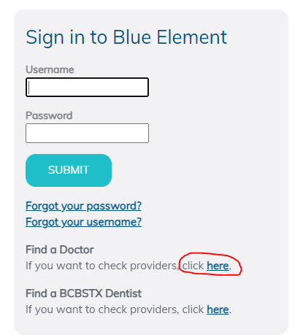


Medical- BCBSTX
(BlueCross BlueShield of TX)
New Medical Vendor!
National Network- Blue Choice PPO
Provider Search: myblueelementtx.com
OptumRx will still provide prescription benefits

Slide 6
SAME Two Medical Plan Options
Health Center Plan
Consumer Choice Plan
Free primary physician (PCP) care at City Designated health centers
Copays for Specialists, Non-Health Center PCPs, OBGYN, Pediatricians and Prescriptions
Lower deductibles and out of pocket costs
Health Savings Account (HSA)
High-deductible
Members will be able to use the health centers at a discounted rate
Deductible & Coinsurance for complex imaging & surgery
ALL Services apply to deductible except preventive care
All preventive care, including mammograms and colonoscopies, are free to members on both the
Health Center Plan and the Consumer Choice Plan

Slide 7
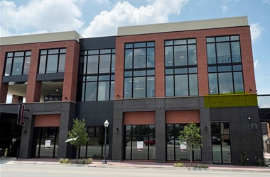
Health Center Locations
Magnolia
  1320 Hemphill St. Ste 350
  Bilingual physician- Dr. Campbell
Riverside
  Police Officer’s Association Building:
  100 N. Forest Park Blvd, Ste 120
  Bilingual physician- Dr. Mejia
Lake Worth
  4701 Boat Club Road, Ste 325
Huguley
  12001 South Freeway, Ste 208
  Medical Office Building 5
Satellite Locations:
Bedford: 3024 State Hwy 121
Burleson: 2730 SW Wilshire Blvd
SW Fort Worth: 7001 Granbury Rd
Willow Park: 101 Crown Pointe Blvd, Ste 200
Keller: 100 Bourland Rd, Ste170

Slide 8






Special Programs included with enrollment in either medical plan option
Telemedicine (Virtual Visits)
Mental Health Services available
Virtual Physical Therapy
REBRANDED TO
Musculoskeletal Rehabilitation- relief in about 3 visits
Total Heart Health- Blood Pressure and Cholesterol management program
Same previous services just a new name
Bundled billing for savings nonemergency surgeries.
Cancer Care
Type 2 diabetes management program

Slide 9
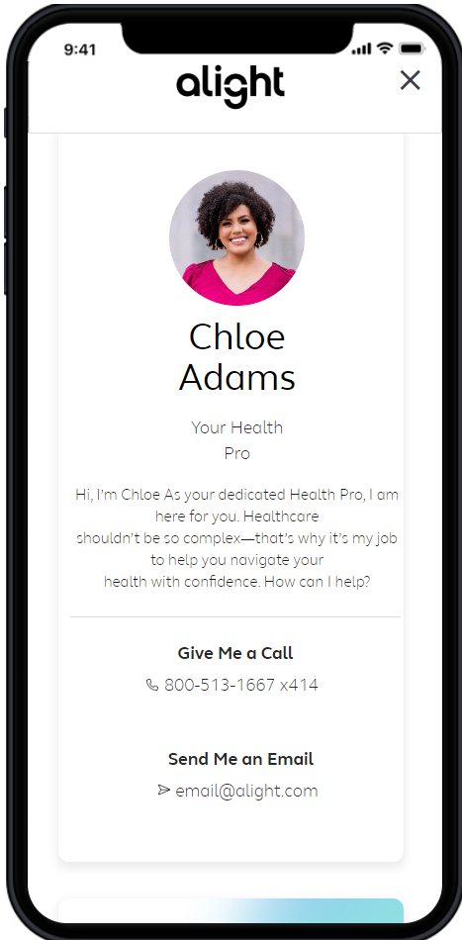
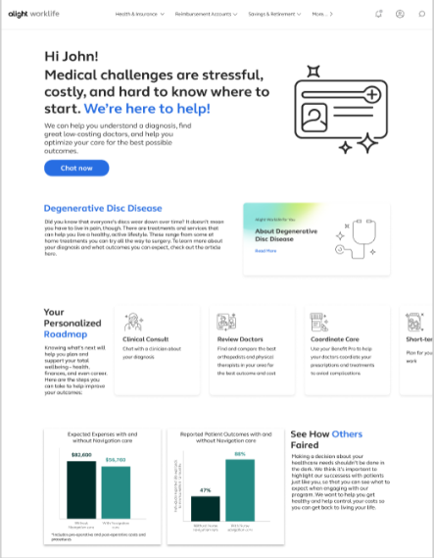

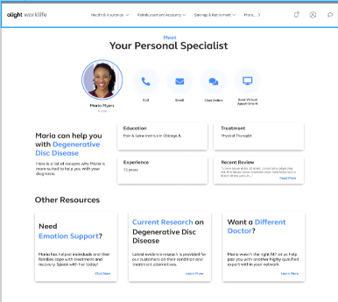
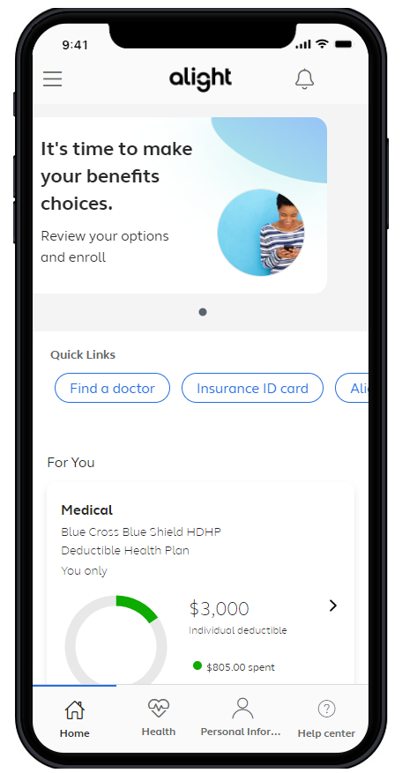
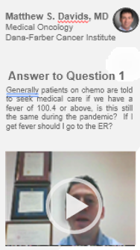
A connected experience – right time, right resource
Diagnosis
Doctor
Treatment
Facility
Coping
Comprehensive Benefits Navigation
--General benefits questions --Provider recommendations -Procedure cost estimates -Program referrals | -Coordination of care -Prescription reviews -Bill reviews
Clinical Decision Support
-Support for any health condition and treatment options -Curated content -Comprehensive clinical intake | -Physician conference calls -Pre-appointment prep -Emotional support for participants and caregivers
Expert Medical Opinions (EMO)
-Virtual second opinions with leading experts -Confirm a diagnosis and treatment options | -Multi-disciplinary consults for complex cases -Referrals to high-quality physicians for in-person care
Surgery Decision Support
-Understand the risks and benefits of any surgery -Alternative treatment options | -Pain management techniques -Incentives tied to elective surgeries for lower back, hip or knee replacement, weight loss, or hysterectomy

Slide 10
2025 Medical Rates
 | Health Center Plan |  | Consumer Choice Plan
 | Per Paycheck | Month | Per Paycheck | Month
Employee Only | $52.64 | $114.06 | $0 | $0
Employee + Spouse | $260.47 | $564.36 | $176.65 | $382.75
Employee + Child(ren) | $194.34 | $421.07 | $126.50 | $274.08
Employee + Family | $364.39 | $789.52 | $264.98 | $574.13
*Participants in the Consumer Choice Plan could contribute that premium difference in their Health Savings Account pre-tax to save for future medical expenses.
Assumes all three wellness requirements have been met

Slide 11
FSA & HSA Reminders
Flexible Spending Account (FSA)
HealthCare FSA
Health Savings Account (HSA)
City will contribute (end of Jan. 2025)
Max contribution: $3,200
$610 for Employee only
$1,000 for Family
Full Balance Rolls over from Year to Year
Must be enrolled in Consumer Choice Plan for medical coverage
Rollover up to $610
Max Contribution: $5,000
ZERO Rollover
Must RE-ELECT each year
Dependent Care FSA
Max Contributions for 2025:
$4,300 individual / $8,550 Family
HealthCare FSA and HSA can be used for Medical, RX, Dental and Vision Expenses

Slide 12


Dental- MetLife
New Dental Vendor!
Similar 3 plan options: DPPO High, DPPO Low, DHMO
PPO Network: PDP Plus
DHMO Network: Dental HMO/Managed Care
Metlife.com/insurance/dental-insurance

Slide 13
Dental Plan Comparison
 | DPPO High Option | DPPO Low Option | Delta Care DHMO Option
Deductible | $50 per person $150 per family | $50 per person $150 per family | None
Annual Maximum | $2,250 per person | $1,250 per person | None
Preventive & Diagnostic Care | 100% Deductible Waived (4 Cleanings per year) | 100% Deductible Waived (4 Cleanings per year) | Fixed schedule of copays
Basic Restorative Care | Plan pays 80% After Deductible | Plan pays 50% After Deductible | Fixed schedule of copays. Specialist referral is REQUIRED
Major Restorative Care | Plan pays 50% After deductible | Plan pays 50% After Deductible
Orthodontia | Plan pays 50% Lifetime Maximum $1,500 | Plan pays 50% Lifetime Maximum $1,000
Implants | Plan Pays 50% After Deductible | Plan pays 50% After Deductible | Limited Coverage

Slide 14
2025 Dental Rates
Bi-Weekly (per paycheck)
New
LOWER
Rates
 | DPPO High | DPPO Low | DHMO
Employee Only | $15.51 | $10.44 | $5.31
Employee + Spouse | $31.79 | $19.84 | $10.08
Employee + Child(ren) | $41.10 | $22.98 | $10.62
Employee + Family | $51.94 | $32.38 | $16.46

Slide 15


Vision- MetLife
New Vision Vendor!
Similar 2 plan options- High & Low
Network: Superior Vision
Metlife.com/insurance/vision-insurance

Slide 16
Vision Plan Comparison
 | High | Low
Exam (once every calendar year) | $0 copay | $0 copay
Standard Contact Lens Fit & Follow up | $10 copay | $10 copay
Contact Lenses Allowance | $150 | $125
Frames Allowance | $200 Every Calendar Year | $180 Every Other Calendar Year
Lenses – Single, Bifocal, Trifocal | $10 copay | $20 copay
Lenses – Progressive I, II, III, IV | $55, $110, $150, $225 copay | $55, $110, $150, $225 copay

Slide 17
2025 Vision Rates
Bi-Weekly (per paycheck)
New
LOWER
Rates
 | High | Low
Employee Only | $5.38 | $2.35
Employee + Spouse | $10.20 | $4.47
Employee + Child(ren) | $10.74 | $4.70
Employee + Family | $15.78 | $6.91

Slide 18
Wellness Update

Slide 19

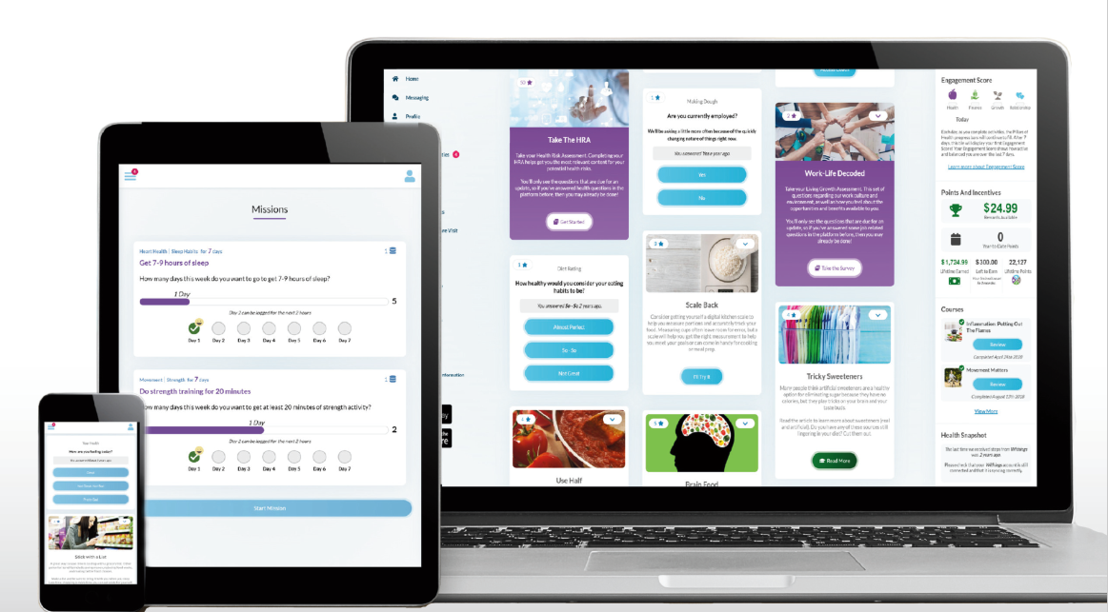
Wellness- Ramp Health
NEW! Wellness Vendor
Same deadlines – August 31, 2025
Same requirements for Premium Incentive and Cash Payout
Easy-to-use, engaging platform available on desktop and mobile
Health and Wellness Coaching
Online Challenges
And more!

Slide 20

Health, Safety & Benefits Fair
Wednesday October 16th
9:00 AM – 2:00 PM
Will Rogers, 3401 W. Lancaster
Representatives from safety, health, local non-profits will be in attendance
Flu Shots will be available
Door prizes
Earn points towards Healthy Challenge Cash Payout
Online Enrollment Support
Register Now

Slide 21

Where can you find more information?
On the city’s webpage you can
learn more about:
Plan Comparisons
Plan Design
Open Enrollment Meeting Dates
Healthcare Vendors
Frequently Asked Questions (FAQs)
https://www.fortworthtexas.gov/departments/hr/employees/openenrollment

Slide 22


Online Enrollment
At home
Enroll from any desktop or laptop: www.cfwbenefits.com
Upload proof documents online – birth certificates, marriage license, etc.
Online enrollment help:
    HR Benefits Office: M-F 8:00 AM – 5:00 PM
    Your Department Human Resources Coordinator (HRC)
Or at work
**ALL elections MUST be completed & submitted online by October 25th**
FSA elections will not roll over to next year you must re-elect

Slide 23
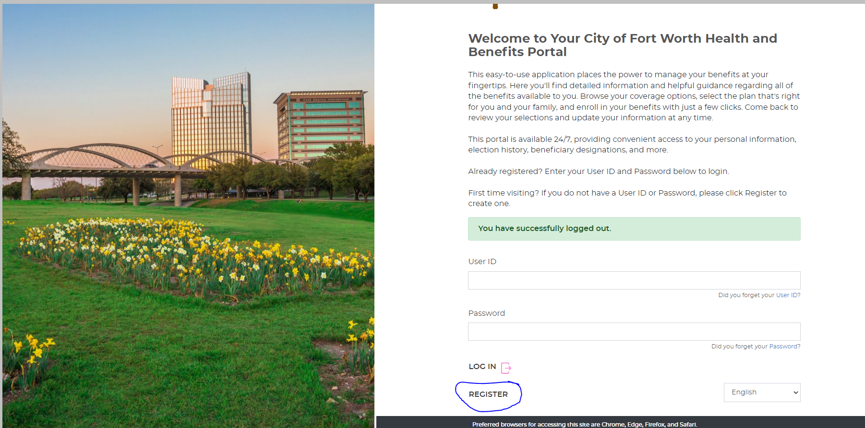
Member Portal Welcome Page

Slide 24
City of Fort Worth HR Benefits Office
100 Fort Worth Trail, Fort Worth, TX 76102
New City Hall- 15th floor
817-392-7782 phone
Alight at 866-307-8835
benefits@fortworthtexas.gov
We MOVED!

