Slide 1
OCTOBER 7 – October 25, 2024
OPEN ENROLLMENT FOR PLAN YEAR 2025
Presented By Human Resources Department

Slide 2
If you are not making changes for 2025, you do not have to do anything.
Your coverage will automatically carry over to 2025.

Slide 3
2025
Medicare
Dental/Vision
New vendor! MetLife
Access to Silver Sneakers
Health Center
If you previously were a Health Center patient, they can now take Medicare
Still 5% coinsurance
Slightly lower premiums
Similar plan designs
Preventative Dental Benefit
Over the counter Medication Reimbursement

Slide 4
Medicare Advantage Plan Reminders
Vision Benefit
$0 Exam Copay
$200 eye wear reimbursement
(once Every 24 months)
Preventive Dental Benefit
$750 Annual Max
Over The Counter Reimbursement
$30 Quarterly

Slide 5
Medicare Part A
Medicare Part D
pharmacy
benefits
How your Medicare Advantage plan works
One step for you
One ID card for medical and pharmacy
A monthly Explanation of Benefits each for medical and pharmacy
Medicare Advantage plans will cover all Medicare-approved services
One plan:
Simplicity
with care advocacy and wellness
More
benefits
than
Medicare
Parts A & B
Medicare Part B
©2018 Aetna Inc.
5

Slide 6
Aetna Medicare Advantage Preferred Provider Organization with an Extended Service Area (PPO ESA)
Access to providers nationwide
Your doctor does not have to be in our network
Same benefits in or out of network
No referrals needed
Covers you nationally when traveling
You’re covered
in or out of network
6

Slide 7
Will my doctors accept this plan?
Yes, they can, if they are:
Eligible to receive Medicare payment
Willing to accept your Aetna Medicare Advantage plan
Many doctors do. Your copays or cost-share amounts are the same both in and out of network.
©2018 Aetna Inc.
7

Slide 8
Will my doctors accept this plan?
It’s easy to find out if your doctor accepts the Aetna Medicare Advantage PPO Extended Service Area (ESA) plan
Call 1-888-267-2637 (TTY: 711),
Monday – Friday,
8 a.m. to 6 p.m. all time zones
Click
aetnamedicare.com
Can’t find your doctor online?
Call us.
It’s likely they may still accept the plan.
©2018 Aetna Inc.
8

Slide 9
Your medical benefits
 | Medicare Advantage plan
Deductible | $0
Out-of-pocket maximum | $1,000
Preventive care | $0
Primary care office visit | 5%
Specialty care office visit | 5%
Inpatient hospital | $250 per stay
Outpatient surgery | 5%
Emergency room (worldwide coverage) | $50 waived if admitted
©2018 Aetna Inc.
9

Slide 10
Aetna’s Prescription Drug Plan offers you:
 | 65,000 pharmacies- with 24,000 preferred pharmacies nationwide *
 | Aetna Rx Home Delivery®
 | Easy-to-use online tools
*The number of pharmacies listed is approximate and is subject to change, due to CMS' "any willing provider" requirement as well as ongoing contracting efforts. Data is current as of 7/1/18 and is subject to change.
©2018 Aetna Inc.
10

Slide 11
Your prescription drug benefits
 | Aetna Part D plan
Deductible | $100
Tier 1 Generics | $10
Tier 2 Preferred Brand | $30
Tier 3 Non-preferred Brand | $50
Tier 4 Specialty | 20% but not more than $200
Coverage gap | Full gap coverage
Need help looking up a covered drug | Call us 1-888-267-2637
©2018 Aetna Inc.
11

Slide 12
A health care professional comes to your home.
What is a
Well-being assessment
Review medications
Healthy Home Visit?
Total health screening
Home safety check
We can share results with your doctor.
We can provide referrals into support programs.
12

Slide 13
Special Features
SilverSneakers
Vision/Hearing Benefit
Up to $200 eyewear reimbursement every 24 months -800-793-8616
Access to fitness locations and SilverSneakers group exercise classes
FLEX – classes and walking groups online class locator
Up to $2,000 hearing aid reimbursement every 36 months – 888-267-2637
Connect Online to assess health and activity and get support from community
888-423-4632 or silversneakers.com

Slide 14
Aetna
1-888-267-2637 (TTY: 711), 8 a.m. to 6 p.m. all time zones, Monday through Friday
Important information!
aetnamedicare.com
Need help with looking up covered drugs or questions call us at
1-888-267-2637, 8 a.m. to 4:30 p.m. CT, Monday through Friday
14

Slide 15
Enjoy your Aetna Medicare Advantage plan
©2018 Aetna Inc.
15

Slide 16
DENTAL PLANS
NEW Provider- MetLife

Slide 17
Dental- MetLife
New Dental Vendor!
Similar 3 plan options: DPPO High, DPPO Low, DHMO
PPO Network: PDP Plus
DHMO Network: Dental HMO/Managed Care
Metlife.com/insurance/dental-insurance

Slide 18
Dental Plan Comparison
 | DPPO High Option | DPPO Low Option | Delta Care DHMO Option
Deductible | $50 per person $150 per family | $50 per person $150 per family | None
Annual Maximum | $2,250 per person | $1,250 per person | None
Preventive & Diagnostic Care | 100% Deductible Waived (4 Cleanings per year) | 100% Deductible Waived (4 Cleanings per year) | Fixed schedule of copays
Basic Restorative Care | Plan pays 80% After Deductible | Plan pays 50% After Deductible | Fixed schedule of copays. Specialist referral is REQUIRED
Major Restorative Care | Plan pays 50% After deductible | Plan pays 50% After Deductible
Orthodontia | Plan pays 50% Lifetime Maximum $1,500 | Plan pays 50% Lifetime Maximum $1,000
Implants | Plan Pays 50% After Deductible | Plan pays 50% After Deductible | Limited Coverage

Slide 19
2025 Dental Rates Monthly (per paycheck)
New
LOWER
Rates
 | DPPO High | DPPO Low | DHMO
Retiree Only | $33.60 | $22.62 | $11.50
Retiree + Spouse | $68.87 | $42.98 | $21.85
Retiree + Child(ren) | $89.04 | $49.78 | $23.00
Retiree + Family | $112.54 | $70.15 | $35.66

Slide 20
VISION PLAN
NEW Provider- MetLife

Slide 21
Vision- MetLife
New Vision Vendor!
Similar 2 plan options- High & Low
Network: Superior Vision
Metlife.com/insurance/vision-insurance

Slide 22
Vision Plan Comparison
 | High | Low
Exam (once every calendar year) | $0 copay | $0 copay
Standard Contact Lens Fit & Follow up | $10 copay | $10 copay
Contact Lenses Allowance | $150 | $125
Frames Allowance | $200 Every Calendar Year | $180 Every Other Calendar Year
Lenses – Single, Bifocal, Trifocal | $10 copay | $20 copay
Lenses – Progressive I, II, III, IV | $55, $110, $150, $225 copay | $55, $110, $150, $225 copay

Slide 23
2025 Vision Rates Monthly (per paycheck)
New
LOWER
Rates
 | High | Low
Retiree Only | $11.65 | $5.10
Retiree + Spouse | $22.11 | $9.68
Retiree + Child(ren) | $23.27 | $10.19
Retiree + Family | $34.20 | $14.97

Slide 24
WELLNESS PROGRAM

Slide 25
Classes
Fit Camp
Lunch N Learns
Seminars/Webinars
Special Challenges & Events
Airrosti – Musculoskeletal
Healthy Challenge Stress Management
Right Step – Opioids in the Workplace
TIAA – Financial Wellness
Blood Drives
Yoga
Total Body Blast
Health, Safety & Benefits (HSBF)
Heart Walk
Free Form Chiropractic
Lantern (formerly SurgeryPlus)
http://roundup.fortworthtexas.gov/wellness/

Slide 26
OTHER BENEFITS
Ticket Discounts, Travel Deals and more…

Slide 27
Beneplace
Discount Site: Tickets
Car rental
Vacation Big Ticket Items
www.beneplace.com/cofw

Slide 28
HELP/COMMUNICATIONS
WHERE TO FIND MORE INFORMATION

Slide 29
Go online to the Open Enrollment page
On the city’s webpage you can learn more about:
Plan Comparisons
Plan Design
Open Enrollment Meeting Dates
Healthcare Vendors
Frequently Asked Questions (FAQs)
https://www.fortworthtexas.gov/departments/hr/employees/openenrollment

Slide 30
HOW TO ENROLL ONLINE

Slide 31
Online Enrollment
At home
Enroll from any desktop or laptop: www.cfwbenefits.com
Online enrollment help available:
Kiosk in HR Benefits Office:
Monday -Friday 8:00 AM – 5:00 PM
Or at work
**ALL changes MUST be completed & submitted online by October 25th**

Slide 32
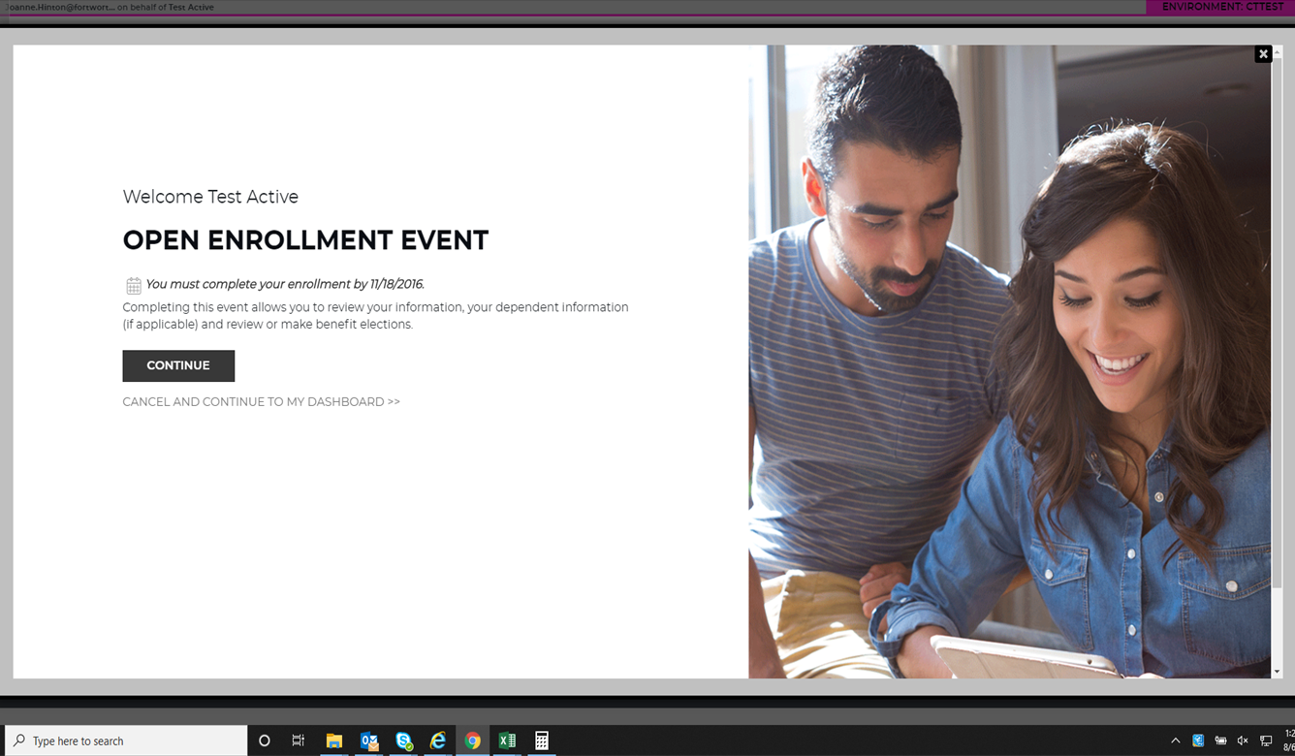
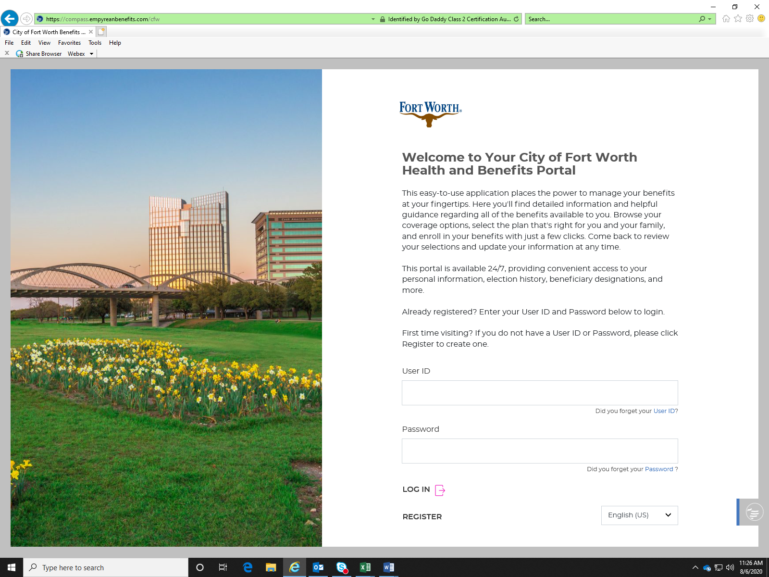
Online Enrollment Platform
www.cfwbenefits.com
Easier to use & More Streamlined!
Notes:
Laurie
Your Health Assistants & Front Line Care Team have a huge impact on savings - by helping members understand how to use their benefits and coordinating needs. members receive more preventive services– immunizations, well visits for children and adults at their PCP, recommended screenings - All increase as a result of Health Assistants providing the exact education and resource each member needs, and always with a lens toward any clinical need that a nurse or BH specialist can support. . All while providing benefits education, claims support, logistics and more, for the whole family.
A 2015 study into Health Care Advocacy concluded that the most important principle to engaging consumers is supporting their ability understand and act on health information. Accolade is built on the principle of putting the member at the center of care, which is why the role of the Health Assistant is so broad & so vital
Your Accolade platform provides a comprehensive view of each member by first ingesting, then integrating data that typically is not brought together, to build member profiles. Accolade’s front line care team review data on conditions, medications the member is taking, self service provider searches to name a few. We view claims so we understand how the member is using healthcare. And all this data is refreshed on a nightly basis & up to date. We use this data in really smart ways – creating a series of triggers and alerts to draw the Health Assistant’s attention to a variety of opportunities to personalize interactions. Answering transactional questions and needs but with the ability to probe and assist further all for the purpose of creating a simpler healthcare experience for your members.

Slide 33
City of Fort Worth HR Benefits Office
100 Fort Worth Trail, Fort Worth, TX 76102
New City Hall- 15th floor
817-392-7782 phone
Alight at 866-307-8835
benefits@fortworthtexas.gov
We MOVED!

Slide 34
QUESTIONS

