Slide 1


OCTOBER 7 – October 25, 2024
OPEN ENROLLMENT FOR PLAN YEAR 2025
Presented By Human Resources Department

Slide 2

If you are not making changes for 2025,
you do not have to do anything.
Your coverage will automatically carry over to the new carriers for 2025.
You will receive BlueCross BlueShield medical ID cards for 2025.

Slide 3
OE FAST FACTS
Online Access To Enroll via our online system cfwbenefits.com Starts October 7, 2024
Open Enrollment Deadline for ALL Plans is October 25, 2024, 11:59 pm
Changes Are Effective January 1, 2025

Slide 4
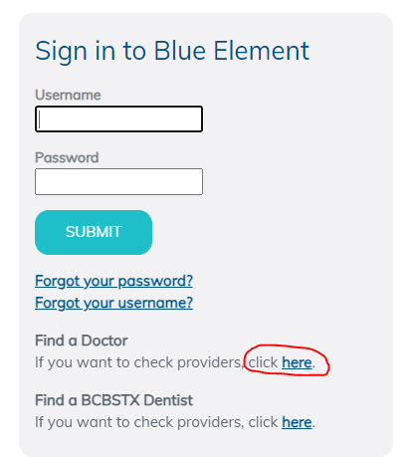


Medical- BCBSTX
(BlueCross BlueShield of TX)
New Medical Vendor!
SAME 2 plan options
National Network- Blue Choice PPO
Provider Search: myblueelementtx.com
OptumRx will still provide prescription benefits

Slide 5
SAME Two Medical Plan Options
Health Center Plan
Consumer Choice Plan
Free primary physician (PCP) care at City Designated health centers
Copays for specialists, Non-Health Center PCPs, OBGYN, Pediatricians and prescriptions
Lower deductibles and out of pocket costs
Health Savings Account (HSA)
High-deductible
Members will be able to use the health centers at a discounted rate
Deductible & Coinsurance for complex imaging, surgery
ALL Services apply to deductible except preventive care
All preventive care, including mammograms and colonoscopies, are free to members on both the
Health Center Plan and the Consumer Choice Plan

Slide 6


Medical- BCBSTX
(BlueCross BlueShield of TX)
Health Center Plan:
Primary Care (Family Medicine, Internists, OB/Gyn, Pediatricians)
  All Health Center services are FREE
  All other Primary Care Providers = $30 co-pay
Specialists (All other physicians) = $50 co-pay
Find a provider = myblueelementtx.com
  National Network- Blue Choice PPO
No Coverage for Out-of-Network Providers
  Except emergencies and certain surgery situations

Slide 7
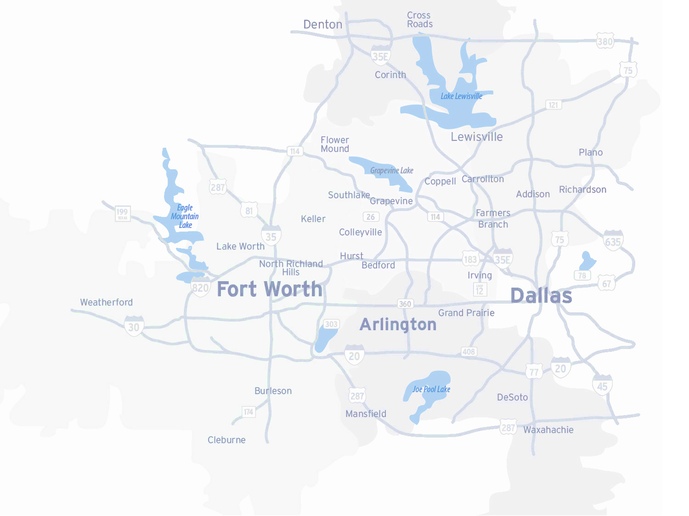
Dedicated/ Primary Health Centers
Four (4) Dedicated Health Centers
  Texas Health Resource Physicians at each location
  Only available for Employees and Retiree enrolled in Health plans
  Same or next day appointments for sick visits
  Short wait times when patients make an appointment and arrive on time
  Hours Monday – Friday
  8:00 AM – 5:00 PM
  Call Care Coordinators to set an appointment
  800-574-0606
  Unlimited Visits
  Health Center Plan $0 Copay
  www.FortWorthEmployeeHealthCenter.com

Slide 8
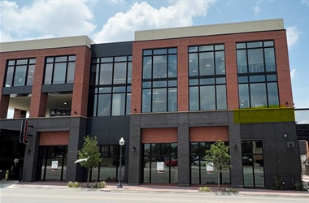
Health Center Locations
Magnolia
  1320 Hemphill St. Ste 350
  Bilingual physician- Dr. Campbell
Riverside
  Police Officer’s Association Building:
  100 N. Forest Park Blvd, Ste 120
  Bilingual physician- Dr. Mejia
Lake Worth
  4701 Boat Club Road, Ste 325
Huguley
  12001 South Freeway, Ste 208
  Medical Office Building 5
Satellite Locations:
Bedford: 3024 State Hwy 121
Burleson: 2730 SW Wilshire Blvd
SW Fort Worth: 7001 Granbury Rd
Willow Park: 101 Crown Pointe Blvd, Ste 200
Keller: 100 Bourland Rd, Ste170

Slide 9
Consumer Choice Plan
Physicians Network
Full access to Blue Choice PPO
No referrals needed for specialists
Co-pay/Co-insurance
Deductible increased to $3,300 individual/$5,400 family
Contributions
City contributes $610/$1,000
Premiums lower than Health Center Plan
Pharmacy – deductible, then 20% co-insurance up to Out-of-Pocket maximum
Can still use the Health Center at a reduced cost
Out of pocket maximums remains at $6,550 individual/$13,000 family

Slide 10
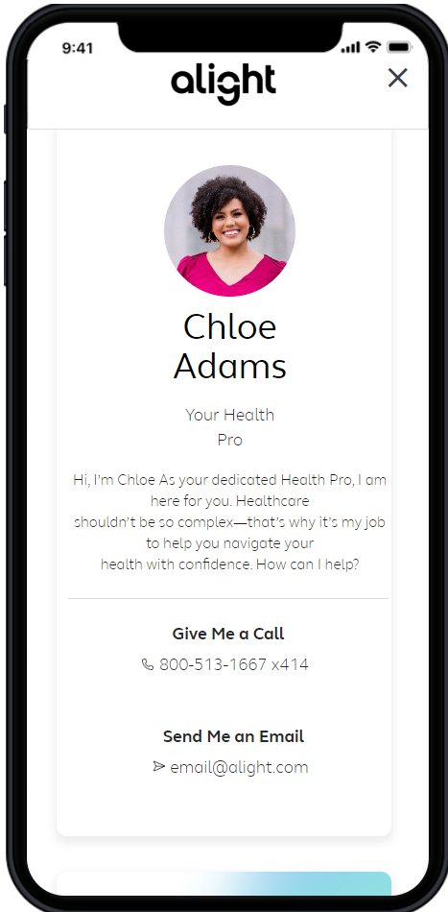
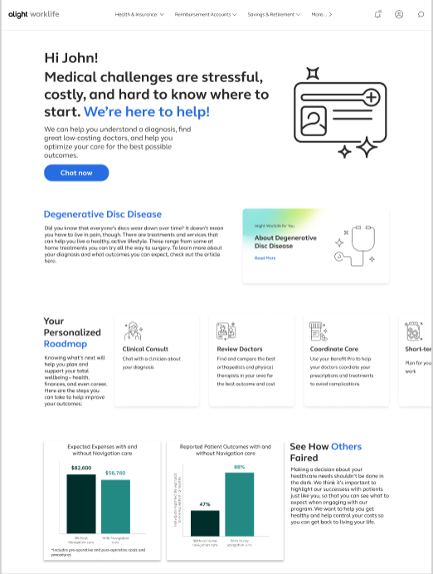

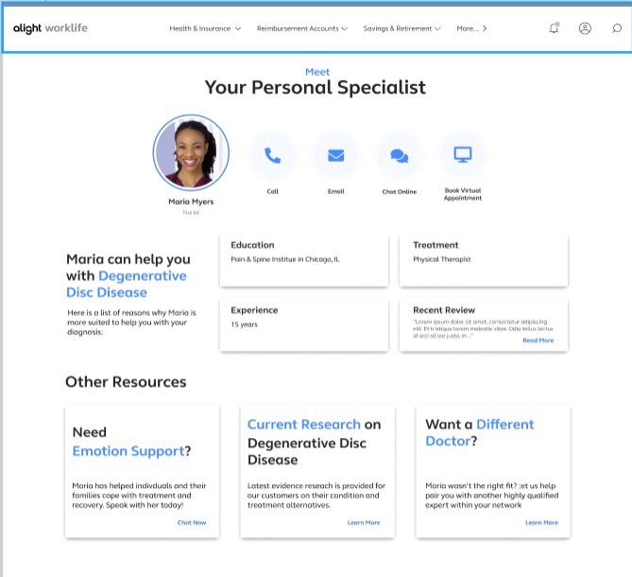
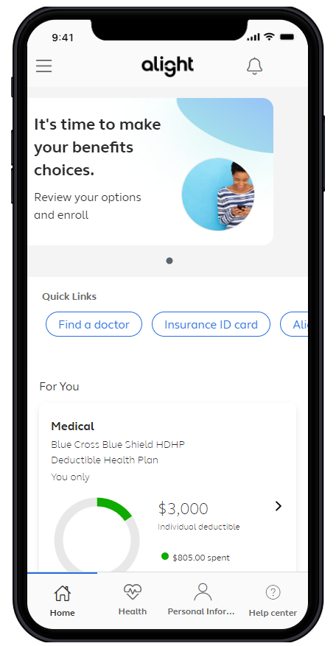
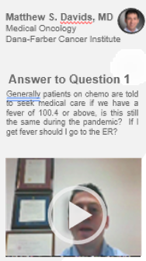
A connected experience – right time, right resource
Diagnosis
Doctor
Treatment
Facility
Coping
Comprehensive Benefits Navigation
--General benefits questions --Provider recommendations -Procedure cost estimates -Program referrals | -Coordination of care -Prescription reviews -Bill reviews
Clinical Decision Support
-Support for any health condition and treatment options -Curated content -Comprehensive clinical intake | -Physician conference calls -Pre-appointment prep -Emotional support for participants and caregivers
Expert Medical Opinions (EMO)
-Virtual second opinions with leading experts -Confirm a diagnosis and treatment options | -Multi-disciplinary consults for complex cases -Referrals to high-quality physicians for in-person care
Surgery Decision Support
-Understand the risks and benefits of any surgery -Alternative treatment options | -Pain management techniques -Incentives tied to elective surgeries for lower back, hip or knee replacement, weight loss, or hysterectomy

Slide 11






Special Programs included with enrollment in either medical plan option
Telemedicine (Virtual Visits)
Mental Health Services available
Virtual Physical Therapy
REBRANDED TO
Musculoskeletal Rehabilitation- relief in about 3 visits
Total Heart Health- Blood Pressure and Cholesterol management program
Same previous services just a new name
Bundled billing for savings nonemergency surgeries.
Cancer Care
Type 2 diabetes management program

Slide 12


Pharmacy Benefits - OptumRx
Health Center Plan
$100 Deductible, then Coinsurance
Maintenance Medications through Walgreens (retail) or
Consumer Choice Plan
Deductible, then Coinsurance
Medications through Walgreens (retail)
Mail Order
OptumRx Mail Order
90 day supply
Select90 Program for Maintenance Medications
Select90 Program for Maintenance Medications

Slide 13
Health Center Pharmacy Plan
 | Retail | Mail Order/Select 90
Generic | 20% coinsurance, $10 min/$20 max | 20% coinsurance, $25 min/$50 max
Brand Formulary | 20% coinsurance, $30 min/$50 max | 20% coinsurance, $75 min/$125 max
Brand Non-Formulary | 20% coinsurance, $50 min/$70 max | 20% coinsurance, $125 min/$175 max
Specialty | 20% coinsurance, $200 max | 20% coinsurance, $200 max
$100 deductible
Maintenance medications still obtained through mail order or Walgreens

Slide 14
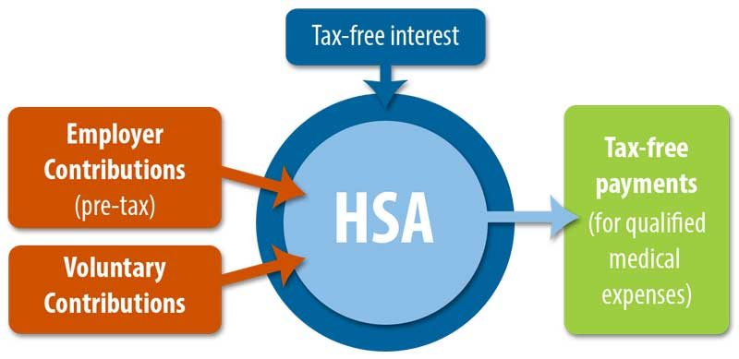
Health Savings Accounts
  Pre-tax dollars to pay for out-of-pocket health care expenses
    You own the account
    No documentation needed
    Grow your account through investments
  Funds rollover from
  year to year
  Must be enrolled in Consumer Choice plan
Doubles as a retirement account
  Withdrawal funds without a penalty at age 65 for non-medical expenses (taxes apply)
City Contribution deposited at the End of January
$610 Retiree only & $1,000 Family

Slide 15

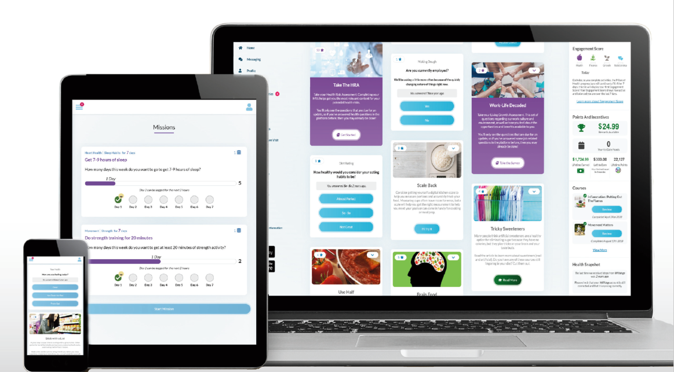
Wellness- Ramp Health
NEW! Wellness Vendor
Same deadlines – August 31, 2025
Same requirements for Premium Incentive
Easy-to-use, engaging platform available on desktop and mobile
Health and Wellness Coaching
Online Challenges
And more!

Slide 16
Wellness Premium Incentive
Main Program – Premium Incentive
Complete a Member Health Assessment (MHA) questionnaire
Purpose of Program
Know your numbers
Have a relationship with a health care provider who knows you
Better insure gaps in care are addressed
Complete the Tobacco Affidavit or Alternative (TOB)
Obtain Annual Physical, and submit the Physician Screening Form (PSF)
$0-$100/Month on Premium
Go to www.fortworthtexas.gov/wellness

Slide 17
Classes
Fit Camp
Lunch N Learns
Seminars/Webinars
Special Challenges & Events
Airrosti – Musculoskeletal
Healthy Challenge Stress Management
Right Step – Opioids in the Workplace
TIAA – Financial Wellness
Blood Drives
Yoga
Total Body Blast
Health, Safety & Benefits (HSBF)
Heart Walk
Free Form Chiropractic
Lantern (formerly SurgeryPlus)
https://www.signupgenius.com/go/10C0F4DACAA2FA6FBC25-healthy3#/

Slide 18
Weight Loss Management Programs
Specific enrollment periods
Enroll online
Learn how to lose weight and improve your health while eating the foods you love. You don't have to starve yourself or count calories to lose weight and keep it off forever.
Weightwatchers reimagined
Enroll online anytime
Easy online app allows you to track food, activity and weight anytime.
Database of online recipes
Weight Watchers coach available 24/7
Online community to provide support
Please Note: Retirees can only enroll in one of the weight loss programs at a time

Slide 19

Dental- MetLife
New Dental Vendor!
Similar 3 plan options: DPPO High, DPPO Low, DHMO
PPO Network: PDP Plus
DHMO Network: Dental HMO/Managed Care
Metlife.com/insurance/dental-insurance

Slide 20
Dental Plan Comparison
 | DPPO High Option | DPPO Low Option | Delta Care DHMO Option
Deductible | $50 per person $150 per family | $50 per person $150 per family | None
Annual Maximum | $2,250 per person | $1,250 per person | None
Preventive & Diagnostic Care | 100% Deductible Waived (4 Cleanings per year) | 100% Deductible Waived (4 Cleanings per year) | Fixed schedule of copays
Basic Restorative Care | Plan pays 80% After Deductible | Plan pays 50% After Deductible | Fixed schedule of copays. Specialist referral is REQUIRED
Major Restorative Care | Plan pays 50% After deductible | Plan pays 50% After Deductible
Orthodontia | Plan pays 50% Lifetime Maximum $1,500 | Plan pays 50% Lifetime Maximum $1,000
Implants | Plan Pays 50% After Deductible | Plan pays 50% After Deductible | Limited Coverage

Slide 21
2025 Dental Rates
Monthly (per paycheck)
New
LOWER
Rates
 | DPPO High | DPPO Low | DHMO
Retiree Only | $33.60 | $22.62 | $11.50
Retiree + Spouse | $68.87 | $42.98 | $21.85
Retiree + Child(ren) | $89.04 | $49.78 | $23.00
Retiree + Family | $112.54 | $70.15 | $35.66

Slide 22


Vision- MetLife
New Vision Vendor!
Similar 2 plan options- High & Low
Network: Superior Vision
Metlife.com/insurance/vision-insurance

Slide 23
Vision Plan Comparison
 | High | Low
Exam (once every calendar year) | $0 copay | $0 copay
Standard Contact Lens Fit & Follow up | $10 copay | $10 copay
Contact Lenses Allowance | $150 | $125
Frames Allowance | $200 Every Calendar Year | $180 Every Other Calendar Year
Lenses – Single, Bifocal, Trifocal | $10 copay | $20 copay
Lenses – Progressive I, II, III, IV | $55, $110, $150, $225 copay | $55, $110, $150, $225 copay

Slide 24
2025 Vision Rates
Monthly (per paycheck)
New
LOWER
Rates
 | High | Low
Retiree Only | $11.65 | $5.10
Retiree + Spouse | $22.11 | $9.68
Retiree + Child(ren) | $23.27 | $10.19
Retiree + Family | $34.20 | $14.97

Slide 25
Turning 65 in 2025?
If you are turning 65 and are eligible for Medicare (have earned your 40 credits), please call Social Security at 800-772-1213 or visit www.socialsecurity.gov three months prior to your birthday month to enroll in Part A & B. When you receive your card call 817-392-7782 or send a copy to benefits@fortworthtexas.gov to enroll in the City’s Medicare Advantage Plan.
If you turn 65 and will never be eligible for Medicare, please call 817-392-7782 to schedule a session to discuss your options.
If you do not enroll into Part B when you reach age 65, you will be charged a 10% penalty by Social Security for every 12 month period you did not enroll and your enrollment will be delayed until July 1. In order to be on the City’s Medicare Advantage Plan you must enroll in Medicare Part A and B
Notes:
Laurie
Your Health Assistants & Front Line Care Team have a huge impact on savings - by helping members understand how to use their benefits and coordinating needs. members receive more preventive services– immunizations, well visits for children and adults at their PCP, recommended screenings - All increase as a result of Health Assistants providing the exact education and resource each member needs, and always with a lens toward any clinical need that a nurse or BH specialist can support. . All while providing benefits education, claims support, logistics and more, for the whole family.
A 2015 study into Health Care Advocacy concluded that the most important principle to engaging consumers is supporting their ability understand and act on health information. Accolade is built on the principle of putting the member at the center of care, which is why the role of the Health Assistant is so broad & so vital
Your Accolade platform provides a comprehensive view of each member by first ingesting, then integrating data that typically is not brought together, to build member profiles. Accolade’s front line care team review data on conditions, medications the member is taking, self service provider searches to name a few. We view claims so we understand how the member is using healthcare. And all this data is refreshed on a nightly basis & up to date. We use this data in really smart ways – creating a series of triggers and alerts to draw the Health Assistant’s attention to a variety of opportunities to personalize interactions. Answering transactional questions and needs but with the ability to probe and assist further all for the purpose of creating a simpler healthcare experience for your members.

Slide 26


Go online to the
Open Enrollment page
On the city’s webpage you can
learn more about:
Plan Comparisons
Plan Design
Open Enrollment Meeting Dates
Healthcare Vendors
Frequently Asked Questions (FAQs)
https://www.fortworthtexas.gov/departments/hr/employees/openenrollment

Slide 27


Online Enrollment
At home
Enroll from any desktop or laptop: www.cfwbenefits.com
Online enrollment help available:
    Kiosk in HR Benefits Office:
    Monday -Friday 8:00 AM – 5:00 PM
Or at work
**ALL changes MUST be completed & submitted online by October 25th**

Slide 28
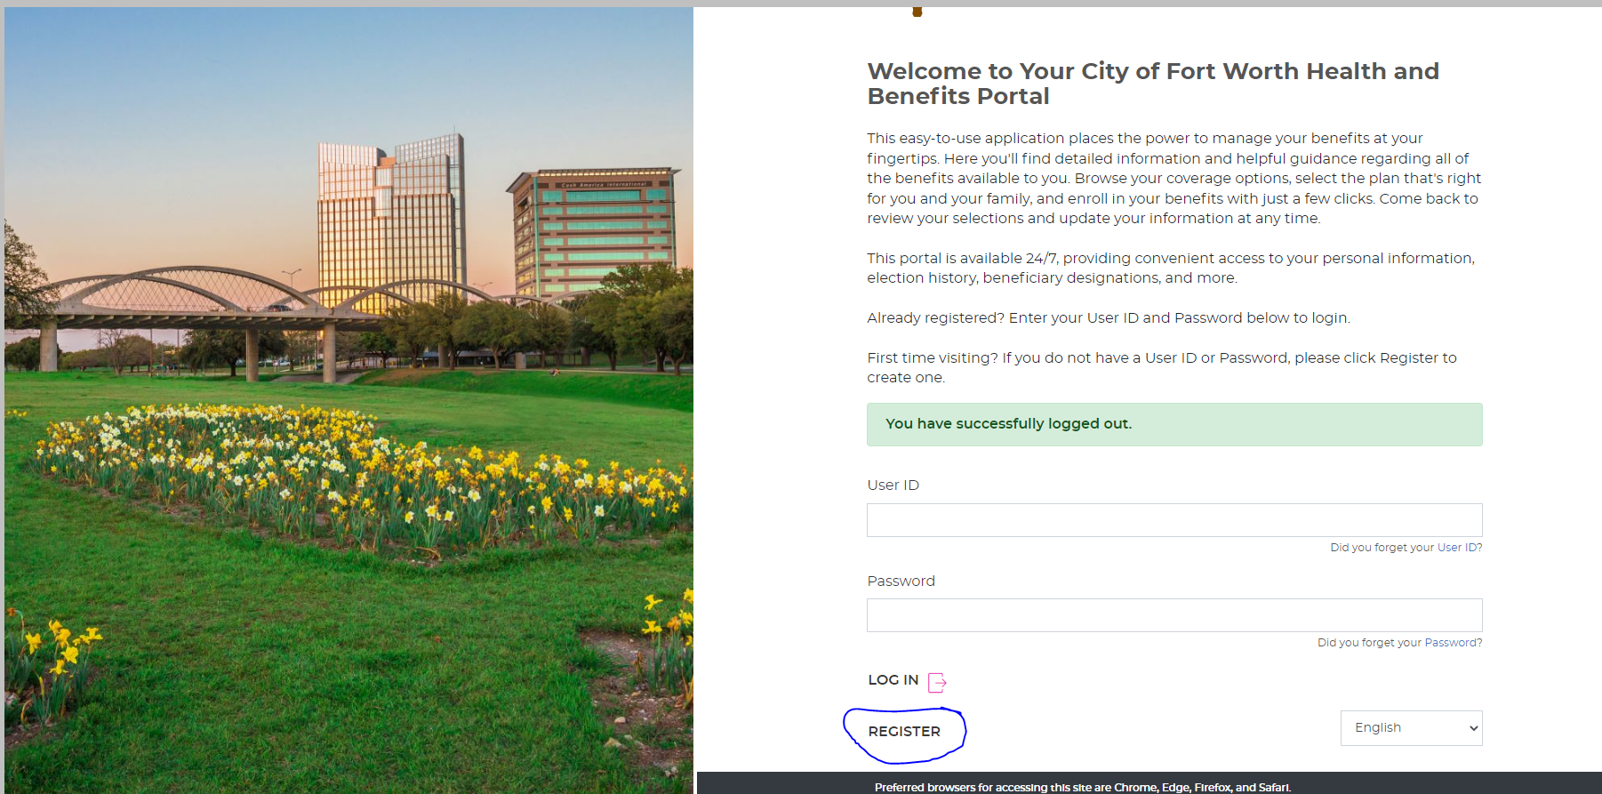
Member Portal Welcome Page

Slide 29
City of Fort Worth HR Benefits Office
100 Fort Worth Trail, Fort Worth, TX 76102
New City Hall- 15th floor
817-392-7782 phone
Alight at 866-307-8835
benefits@fortworthtexas.gov
We MOVED!

Slide 30

QUESTIONS

